Slide 1
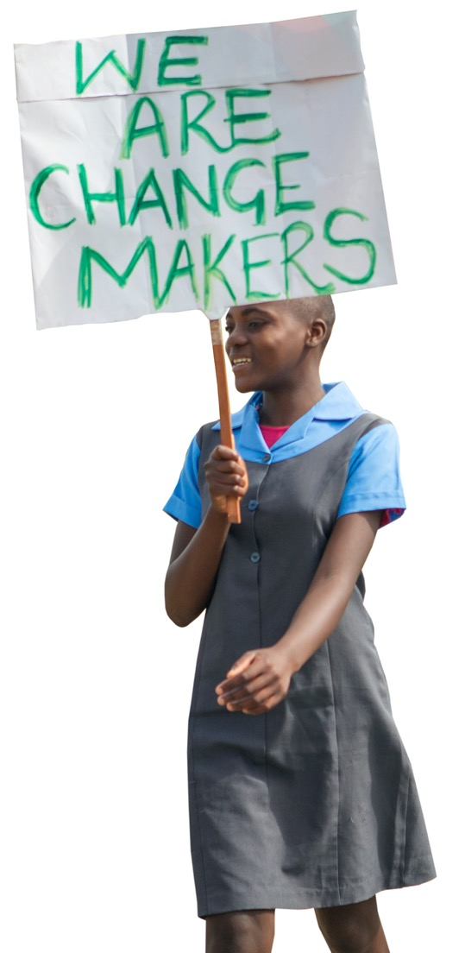

Child Rights & Girls’ Rights
Notes:
This workshop presentation includes:
Basic facts about Child Rights
Basic facts about Girls’ Rights
Dialogue questions and groups work formats.

Slide 2
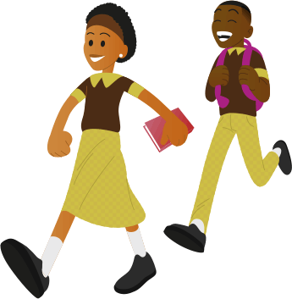
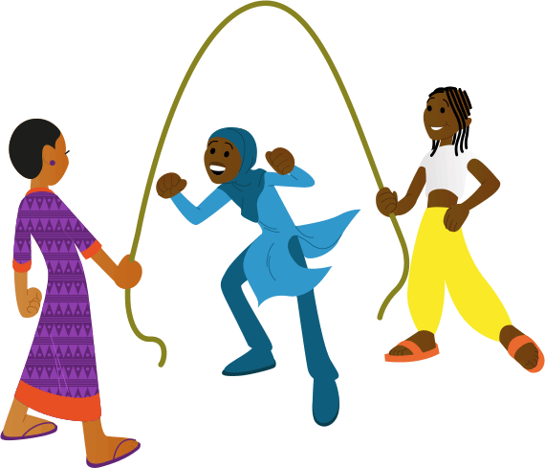
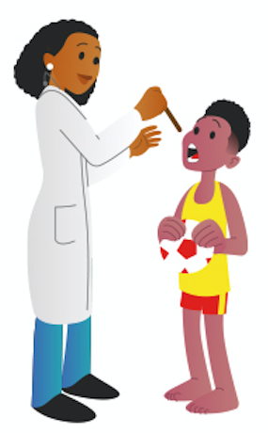
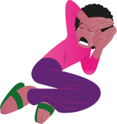
The Rights of the Child
Notes:
Speaking points
We will start by talking about the Rights of the Child.
These are the legitimate rights of children and they apply to every child.
The rights apply to every girl and boy, from birth until the age of 18.
There are many rights concerning everything in a child’s life.
Take a look at these pictures. What rights do you think these are?
To workshop leader:
Point at the pictures and let the group make suggestions. The images represent in order: The right to good health and health care, the right to play, the right to go to school and the right to be protected from violence. If someone says, for example, “you cannot hit children” about the picture on the far right, you can add, “Exactly, every child has the right to protection from violence.”
So, now you know that the Rights of the Child apply to anything that protects children from violence and other poor treatment. And that it also covers children’s right to go to school, play and have enough to eat.

Slide 3
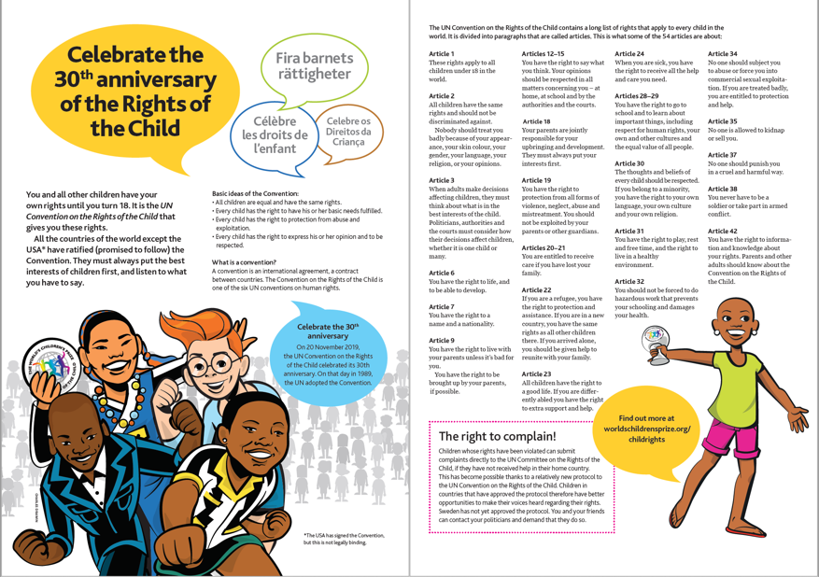
The Rights of the Child
Decided on by the United Nations
Your country has promised to follow it
For all children until they turn 18 years old
Notes:
Notes d'allocution
La Convention relative aux droits de l'enfant a été créée par l'ONU il y a plus de 30 ans, en 1989.
Presque tous les pays de la planète se sont engagés à la respecter, y compris le nôtre. Beaucoup s'est amélioré pour les enfants. Notre pays, par exemple, xxxxx.
(À l’Instructeur : ajoutez ici un exemple local d'une loi dans votre pays qui a été créée pour protéger les enfants, par exemple contre les châtiments corporels ou le mariage des enfants).
Cependant, les Droits de l’Enfant sont toujours bafoués dans notre pays et dans tous les autres pays de diverses manières. Certains enfants sont plus vulnérables que d'autres. Les filles sont souvent plus vulnérables que les garçons. Nous y reviendrons plus tard.
À l'Instructeur : demandez aux participants : Avez-vous, vous-même subi ou vu des violations des Droits de l'Enfant ? Les participants répondent à main levée, où ceux qui répondent oui lèvent la main.
Notre gouvernement s'est engagé à respecter la Convention relative aux Droits de l'Enfant. Cela signifie qu'ils doivent donner la priorité à l'intérêt supérieur des enfants. Ils doivent aussi écouter ce que les enfants ont à dire. Pourtant, les Droits de l’Enfant sont toujours bafoués dans notre pays et dans tous les autres pays, de différentes manières.
Les Droits de l’Enfant sont-ils bafoués là où tu vis ? Oui ou non ?
À l'Instructeur : Dites aux participants de répondre en levant la main, ceux qui répondent « oui » lèvent la main.
Enfin, demandez à 1 - 3 participants de donner de brefs exemples de violations des Droits de l'Enfant. Si personne ne veut rien dire, vous pouvez donner de brefs exemples locaux. Écrivez les exemples au tableau.

Slide 4
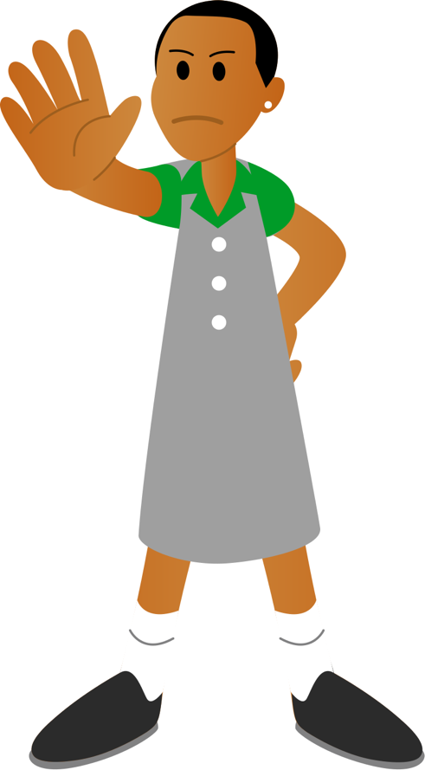
With rights come responsibilities
Listen to and respect other people’s points of view.
Stand up for your rights and for the rights of others.
Think about your actions and how they could impact others.
Support people who are vulnerable and need more care than ourselves.
Notes:
Speaking points
It’s important to know your rights, in particular so you can respect the rights of others.
And with rights come responsibilities. Some of those are:
To listen to and respect other people’s right to express their point of view.
To stand up for our rights and the rights of others. For example, speaking up when we or a child are treated badly.
To always think about our actions and that they can have consequences for people around us.
To care about people who need more support than we do.
To workshop leader: Add brief local examples of at least two of the above points, to improve understanding.

Slide 5
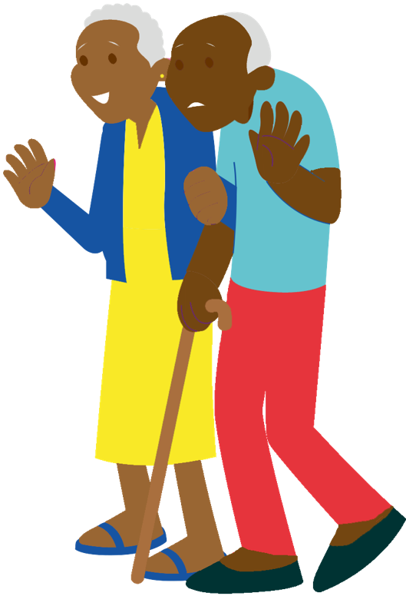
Every person has the right to be treated with respect.
Children should respect adults and adults should respect children.
Adults should bever violate the Rights of the Child, even if children misbehave.
Adults must not tell children to do anything that may be in violation of the Rights of the Child.
Notes:
Every person has the right to be treated with respect.
Children should respect adults and adults should respect children.
Adults must always respect the Rights of the Child, even when children misbehave.
For example, it’s never OK to hit a child, or punish them in a way that violates their rights.
Adults must not demand anything from children that may be in violation of the Rights of the Child. For example, they should never force a child to do jobs that are harmful to their health. Or force children to get married.
Do you think that most adults in our country are aware of the Rights of the Child? Yes or no?
To workshop leader:
Let the participants answer by raising their hands, with those answering ‘yes’ raising their hand).
Can anyone give an example of a common violation that affects children?

Slide 6
What’s it like for you?
Questions to discuss
Turn to the person sitting closest to you.
Talk together for 15 minutes about your situation at home, at school and during free time.
Write down two or more examples of things that you think violate the Rights of the Child where you live.
Are the Rights of the Child respected in your school?
What’s it for you and other children at home and during free time?
Notes:
Speaking points
Now you know more about the Rights of the Child.
Let’s talk about the situation in our country and where you live.
Turn to someone sitting close to you and discuss these questions, in pairs.
Are the Rights of the Child respected where you live?
What’s it like at home, at school and in your free time?
Give each other examples of child rights violations that take place where you live.
Together, write down at least two of these examples.
Those who wish to do so will be able to share some examples when the whole group comes together again.
We’ll tell you when it’s time to stop.
To workshop leader:
Make sure everyone has paper and pens or can make notes on their phones.
Go round the room during the session and offer support where they are having trouble getting a discussion going. Ask questions and give encouragement to get things started.
Tell the group when it is time to stop.

Slide 7
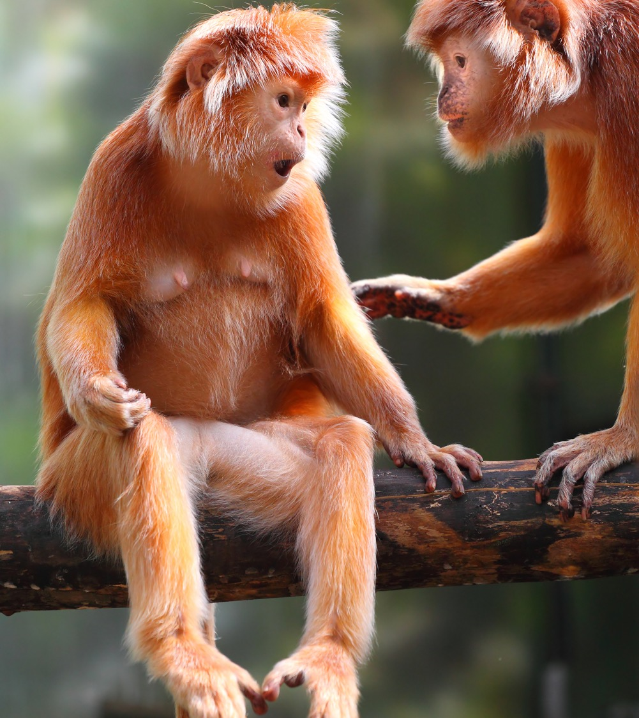
Share and discuss
Notes:
Speaking points
Time’s up!
Who would like to share some examples of what you’ve been discussing?
To workshop leader:
Once everyone who wants to has shared examples, you can open up the floor for a general discussion and comments, depending on time constraints.

Slide 8
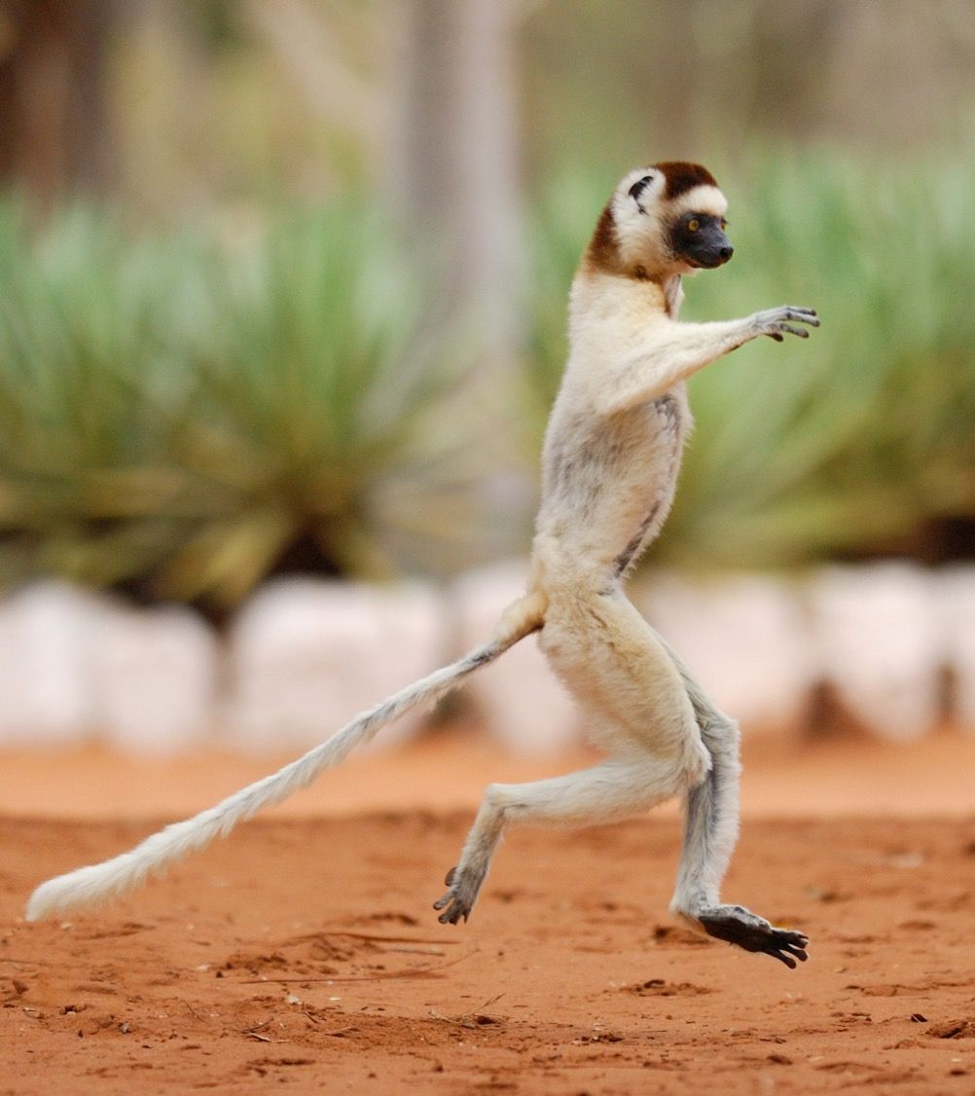
5 minute break
Notes:
To workshop leader:
Do a joint stretching and jumping exercise to loosen up the muscles and boost energy levels. Remember to keep your distance and be Covid-safe!

Slide 9
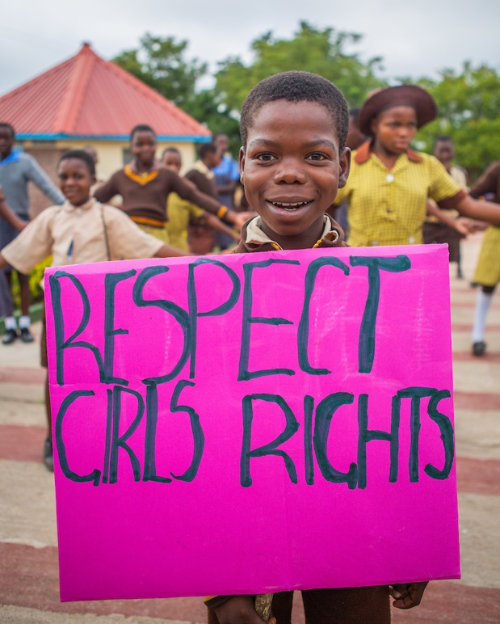
Girls’ equal rights
Girls and boys should have the same rights.
This is stated in the UN Convention on the Rights of the Child, which our country has to follow.
Are girls’ rights always respected where we live and in our country?
What’s it like for girls where you live, at home, in school and in your free time?
Notes:
Speaking points
We’re now going to learn more about girls’ rights.
We will also share our own thoughts and examples, and discuss important issues. Girls and boys should have the same rights.
This is stated in the UN Convention on the Rights of the Child. As you already know, our country has promised to follow it.
Are girls’ rights always respected where we live and in our country?
What’s the situation like for you at home, at school and in your free time?
We’re going to find out more about that now.
But first, we will listen to two children talking about their lives.

Slide 10
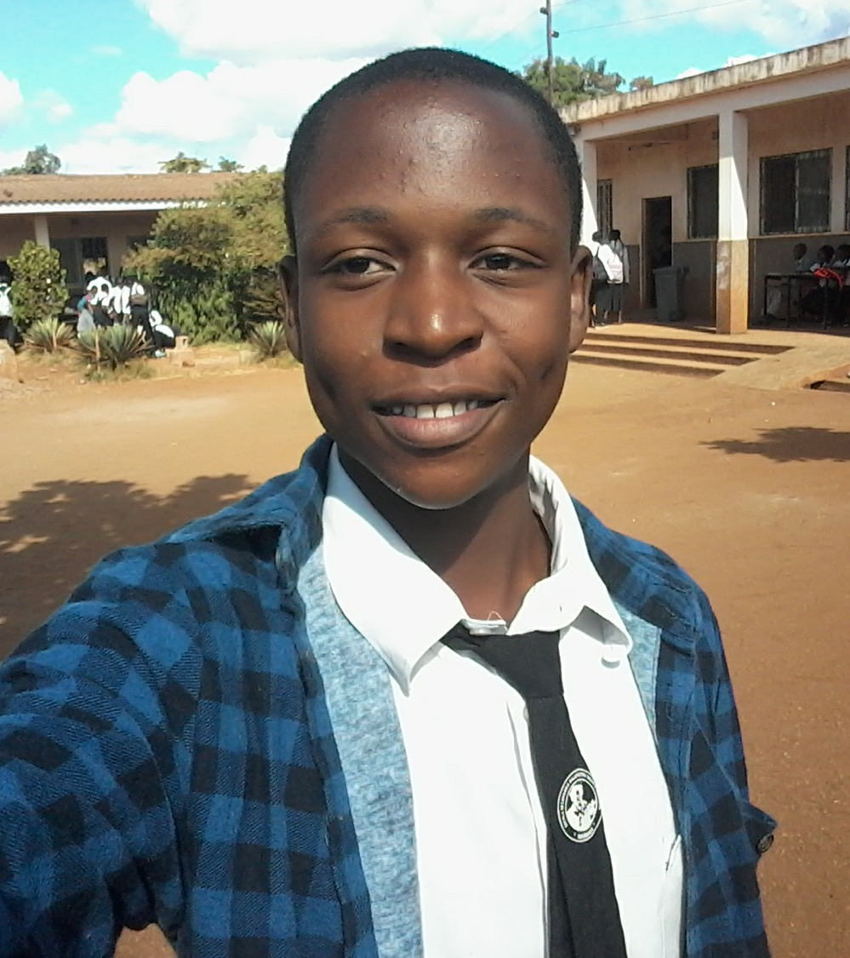
Xadreque
Notes:
To workshop leader: Read Zadreque’s story out loud.
Speaking points
This is Xadreeque from Moçambique. He says:
To workshop leader: Read part of or all of Xadreques story in The Globe out loud, on page 28.
I became a WCP Child Rights Ambassador when I was thirteen years old. After my training I began fighting for equal rights for boys and girls. I had to start by changing my behaviour towards my sisters. My parents had taught me that there are certain things that girls do and certain things that boys do, but I was actually violating my sisters’ rights. “I feel that I have changed because I help now with all the chores at home and respect my sisters. For example, today I initially worked in the field all morning with my mother, and when I returned home, I fetched water. I want to show all boys and men that it is possible and that that is how it should be.”
“I now visit schools and communities to share my knowledge and experience with all boys and girls and fight for equal rights. “If we come across some parents in villages and communities who aren’t respecting girls’ rights, two or three of us Child Rights Ambassadors usually go and visit them together. We talk to them about girls’ rights and how important it is that these are put into practice in their daughters’ lives.
“We usually also hold meetings in schools and communities to explain how girls’ rights should be respected. We share our knowledge about children’s rights and obligations to boys and girls. We discuss, among other things, violence against children, sexual abuse, child marriage and trafficking of children.”
“We also try to get boys to help their sisters and mothers at home. According to Mozambican tradition, boys and men have specific tasks such as working in the fields, building houses and tending livestock. The rest of the household chores and looking after children are for women and girls. I go to the field (machamba), but I also prepare food for my family. I fetch water, wash the dishes and sweep the yard. I hope that all boys around me will follow my example.
“We must get boys and men to understand that they must change their behaviour towards girls. There will be change, but we must never tire of demonstrating the benefits of change. There are currently five of us boys who are Child Rights Ambassadors. We are now working together with local decision-makers such as the district’s education director and the police. “We will never stop fighting for girls’ rights, for many girls’ rights are still being violated. We see how many girls stop attending school because they become pregnant or don’t have enough time to do their homework at home.”

Slide 11
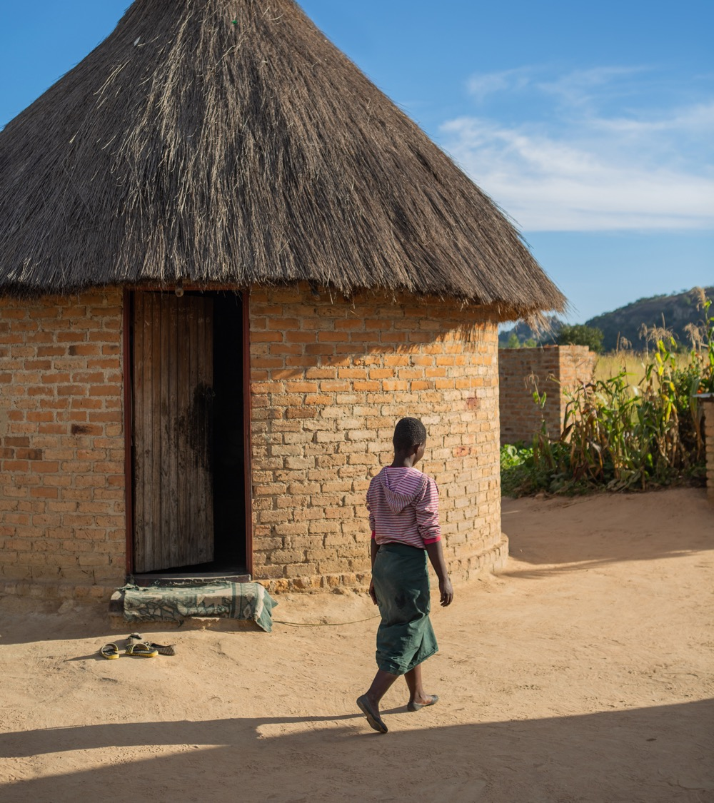
Rutendo
Notes:
To workshop leader: Read Rutendo’s story out loud.
Speaking points
This is Rutendo from Zimbabwe. She says:
“When I was seven years old and in grade one, my father died. Our life became very
difficult. We often went whole days with no food. “Other children at school bullied me and called me poor. We could not pay my school fees and the teacher sent me home. This was repeated every year. I cried every morning when I saw my friends going to school.”
“At the age of ten I moved to my aunt’s place. I had to sweep, wash, cook and fetch water and firewood. But I wasn’t allowed to go to school.
“When I was twelve I came to understand that the husband of my aunt had told my mother that he wanted to marry me as his second wife and that my mother had agreed. “When the man had gone to pay 300 Zimbabwean dollars to my mother, my aunt told me: ‘From now on you have to do what your uncle tells you.’
“It was so painful. I cried every day and thought about committing suicide. “When I asked mother why she let this happen, she also cried. She said that it was not possible for her to say no, as the uncle paid the school fees for my three younger siblings.
“My best friend Precious told me to run away and report my uncle to the police, but I did not dare.” “When I was thirteen my uncle forced himself on me, and by the time I was fifteen I was already pregnant with my second child. “My life became very bad, and when my uncle married a third wife, my grandmother came to fetch me. I now live at her and my grandfather’s place.
“It is so painful when I see my friends going to school, while I have to take care of my two sons and do piecework in other peoples’ homes. I get three Zimbabwean dollars a day. This is only enough to buy a packet of salt.
“My dream is to start school again and one day become a lawyer because I want to other children who have been subjected to violations as I have. But I would also love to become a dressmaker.”

Slide 12
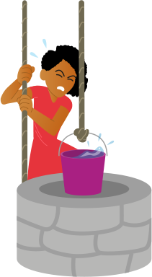
What are girls’ rights?
No-one may be discriminated against (treated worse than others) just because they are a girl. For example when it comes to:
Safety and a good home.
Acting and dressing the way you like.
Saying what you think and being listened to.
Playing, doing sports and getting enough rest.
Going to school and getting a good education.
Feeling healthy
Having equal opportunities and choices in life.
Notes:
Speaking points
All children should have equal rights. Unfortunately, some people don’t think girls have the same worth as boys, and they think they shouldn’t have the same rights.
Girls are also more vulnerable than boys to violations of their rights, for example when it comes to every child’s right to safety and a good home, to be themselves and to say what they think and be listened to.
Girls and boys also have the same right to play, do sports and rest, to go to school and to physical and mental well-being. All children should also have equal opportunities to choose their future career.
To workshop leader:
Some people mistakenly interpret equal rights for girls as meaning that girls have more rights than boys. Boys and men can feel particularly provoked by this. In such cases we may need to explain again, clearly, that all rights are equally important for everyone.
Of course, boys also need to be protected from violence. They should not have to work, and they have the right to go to school. We highlight girls’ rights because it’s more common for their rights to be violated. Particularly some rights, just because they are girls.
This doesn’t mean that there aren’t also boys being hit or who have to work hard or are forced to quit school.
To protect girls’ rights is not the opposite of protecting the rights of boys and men.

Slide 13
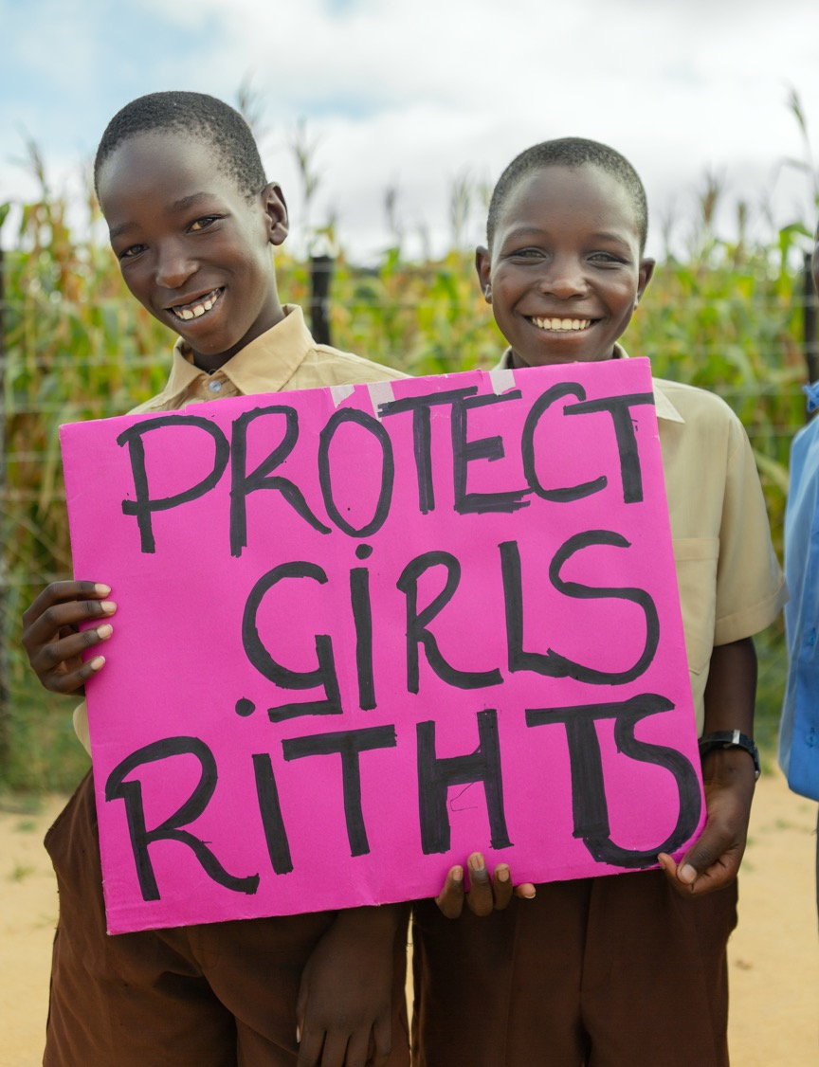
Protecting girls’ rights
Both girls and boys can and should stand up for girls’ rights.
The main responsibility lies with the government and local leaders. They have to protect girls from child rights violations.
Authorities, such as police, courts and school authorities, also have a big responsibility.
All adults including parents have to respect girls’ rights and must try to protect them from abuse and other child rights violations.
Notes:
Speaking points
It’s important that both girls and boys stand up for girls’ rights.
Girls are also entitled to demand that adults respect their rights and protect them if they are violated or threatened.
All adults must respect girls’ rights and protect them from being exposed to violations.
It is first and foremost the leaders of our country and local leaders where we live who should protect girls from violations. This applies to authorities such as the police, courts and school leaders.
Local leaders and parents also have considerable responsibility.
Unfortunately, girls often fail to get the protection to which they are entitled.
To workshop leader:
Give a couple of local examples here of how girls are not given protection and help that the participants might recognize. It could be about them being allowed to finish school, protected from violence, rehabilitation after an assault, etc., and not getting support or protection/help from teachers, head teachers, parents or local leaders.
Speaking points
We will now go through some of the rights that girls should have according to the UN Convention on the Rights of the Child.

Slide 14
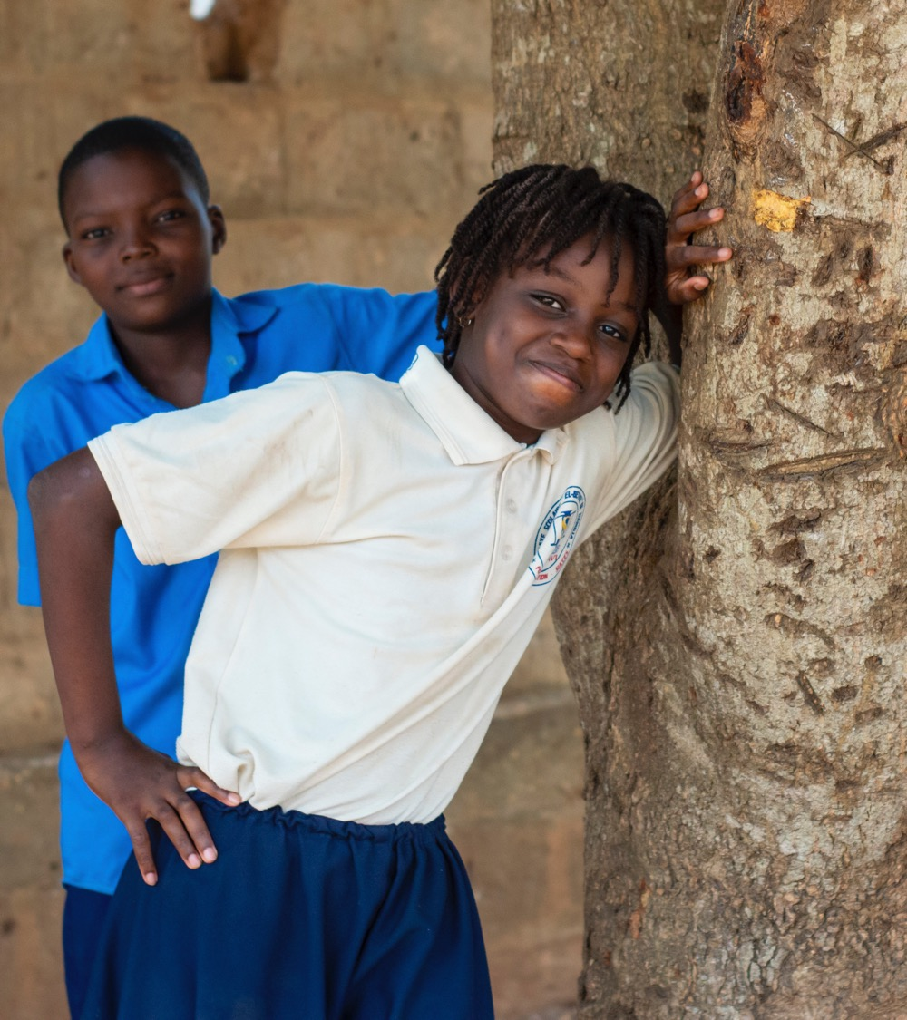
Girls have the right to go to school and get a good education.
Do all girls in our country and where we live have these rights?
Notes:
Speaking points
All children have the right to an education.
Yet still more boys than girls get to start school in our country and all around the world. And many more girls than boys are forced to quit school early.
Sometimes it’s because the parents want their daughters to help out at home. Some think that education is wasted on a daughter, because she will belong to another family when she marries. Others are worried that men will attack their daughters on their way to school.
If the school has no separate toilets for girls, many girls stay home when they start their period. So they end up missing lessons, and those who aren’t able to catch up end up quitting school. Other girls finish because an adult at the school is mistreating them. There are even teachers and head teachers who try to force students to have sex with them by threatening them with low grades and failing them on their exams.
Girls who get an education marry later and have fewer and healthier children. Every extra year a girl attends school increases her future income by up to a fifth! It’s good for her and her family, but also good for the whole country.
To workshop leader:
Adapt the above by adding local examples and facts.
Let the participants raise their hands if they recognize this problem. Some can also give their own examples if they want to.

Slide 15
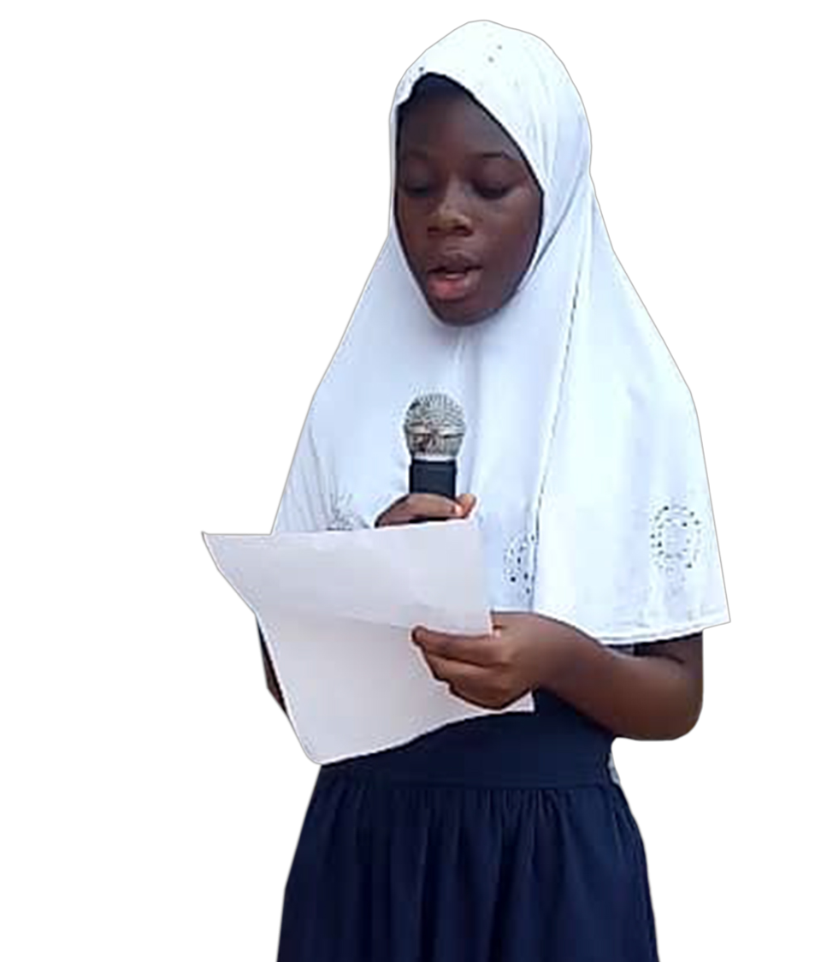
Girls have the right to speak and be listened to.
Do all girls where you live and in our country have these rights?
Notes:
Speaking points
Girls and boys have the same right to say what they think, and to be involved in making decisions about issues that affect them.
Unfortunately it’s often harder for girls than boys to have their voices heard. Many are not listened to either in their family, at school or in society in general.
Girls have fewer opportunities to make decisions about their lives and their own bodies. Girls in rural villages often find it even harder than girls in cities to go to school and have a decent life.
Do all girls where you live and in our country have these rights?
To workshop leader:
Adapt the above by adding local examples and facts.
Let the participants raise their hands if they recognize this problem. Some can also give their own examples if they want to.

Slide 16
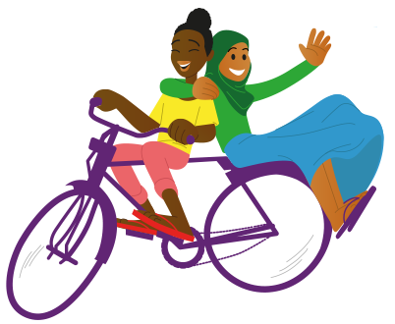
Girls have the right to play, do sports and get enough rest.
Do all girls have these rights where you live and in our country?
Notes:
Speaking points
All children share the same right to play and rest. Play and rest are important for children’s development and well-being.
Children who have time to play, rest and do their homework do better at school and in life. Girls often have much less time for play, rest and homework than boys.
This is because they have to help more at home than their brothers.
While the girls do the cleaning, laundry, cook meals and look after younger siblings, their brothers often get time for themselves. Sometimes mainly girls have to walk long distances, maybe several kilometres, to fetch water.
It’s often dark outside by the time they’ve finished all their chores. Those who
don’t have electricity at home can then find it hard to do their homework.
To workshop leader:
Adapt the above by adding local examples and facts.
Let the participants raise their hands if they recognize this problem. Some can also give their own examples if they want to.

Slide 17
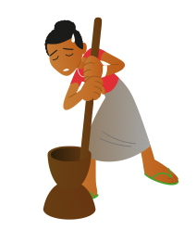
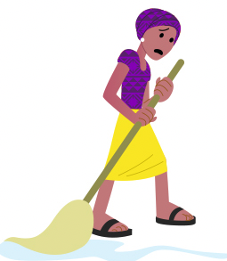
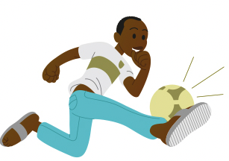
Can girls have more time for play, rest and studying if boys take on a fairer share of the household chores?
Are there other ways of giving girls more free time?
Notes:
Speaking points
Girls need as much time as boys to be able to grow and develop.
If boys do their fair share of the household chores, it gives girls time to play, rest and study. Is that a good solution?
Can you come up with more ways of giving girls more free time?
Let the participants give their own examples if they want to.
To workshop leader:
Adapt the above by adding local examples and facts.
Let the participants raise their hands if they recognize this problem. Some can also give their own examples if they want to.

Slide 18
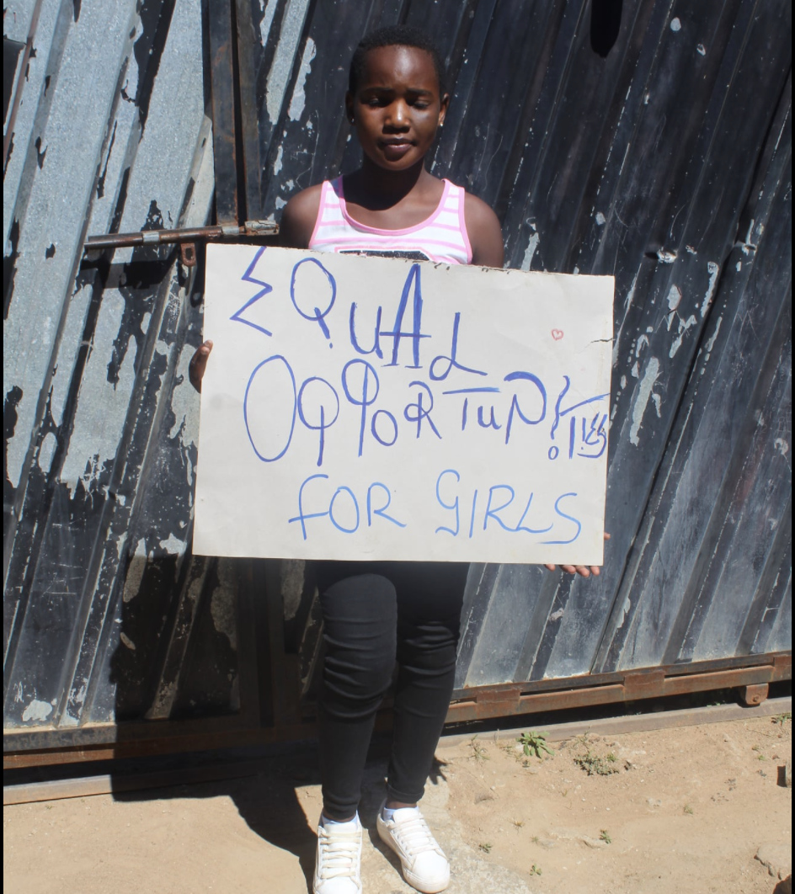
Do all girls where you live and in our country have protection from violence?
Are girls in general empowered and educated so that they can protect themselves and seek help when they need it?
Notes:
Speaking points
All children have the right to protection from violence, both physical and mental.
In many countries in the world, corporal punishment is completely forbidden both at home and at school. Yet it’s still common for adults to subject children to violence.
Girls and their mothers are particularly vulnerable. Girls are sometimes also subjected to violence outside the home, at the hands of both their male peers and older men.
If a girl tells anyone or seeks protection, she is often not believed or given any help. Do you recognize this as a problem for girls where you live and at your school?
To workshop leader:
Adapt the above by adding local examples and facts.
Let the participants raise their hands if they recognize this problem. Some can also give their own examples if they want to.

Slide 19
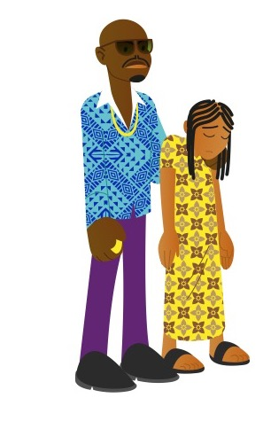
Is child marriage a common problem in our country and where you live?
How does child marriage affect girls’ lives?
Notes:
Speaking points
No-one can be married off while still a child, that is, under the age of 18.
Yet girls in particular are still being forced into child marriage both in our country and in other countries. Twelve million girls in the world are married off every year; that’s 23 girls a minute, every day.
Sometimes girls are forced to marry because the family needs the money or the livestock that the husband’s family give in exchange for a wife.
That can be described as trading in children, selling a child.
Girls who are married off have many of their rights violated. They are often forced to quit school.
Girls who are married off as children are much more exposed to violence from their husbands compared to those who marry as adult women.
It can also be fatal for a girl to give birth before her body is fully grown. Injuries sustained during childbirth are currently the world’s most common cause of death in young girls living in poverty.
To workshop leader:
Adapt the above by adding local examples and facts.
Let the participants raise their hands if they recognize this problem. Some can also give their own examples if they want to.

Slide 20
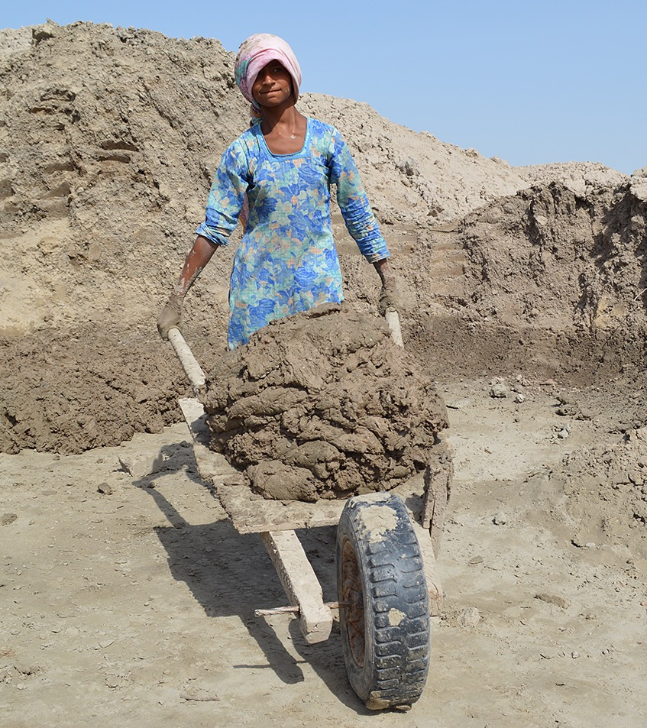
Do girls have to work hard where you live and in our country?
How do you think that this affect girls’ lives?
Do girls and boys have the same right to good health where you live and in our country?
Notes:
Speaking points
No child under the age of 12 should be doing any type of work.
No-one should be working long days with heavy or dangerous tasks until they reach the age of 18. Yet still many children are forced to start working at an early age and carry out tasks that are harmful.
Girls often have some of the lowest paid and most dangerous jobs.
They do tough labour on farms, in factories, at construction sites and as maids in private homes. Sometimes they don’t even get paid, just a little food. What’s it like where you live?
To workshop leader:
Adapt the above by adding local examples
Let the participants raise their hands if they recognize this problem. Some can also give their own examples if they want to.

Slide 21
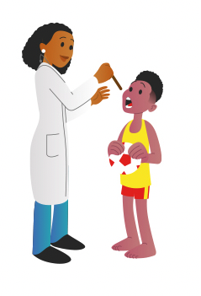
Do girls and boys have the same right to good health where you live and in our country?
Do girls and boys have the same right to good health where you live and in our country?
Do girls and boys have the same right to good health where you live and in our country?
Do girls and boys have the same right to good health where you live and in our country?
Notes:
Speaking points
Girls and boys have the right to be as healthy as possible. They also have the right to care if they become ill.
But when girls fall ill, they often get worse care than boys, particularly in families living in poverty. Sometimes, if there isn’t much food, girls living in poverty get less to eat compared with their brothers.
Boys living in poverty are vaccinated against serious illnesses more often than girls.
In countries where there is a lack of gender equality, more girls die than boys before reaching the age of five. In rich countries, it’s the other way round. More boys die before they reach the age of five.
All children have the right to be healthy and happy in themselves. However, girls are often pressured more than boys to look and behave in a particular way. It could be anything from how they dress, to their dreams for the future and their interests.
Some girls aren’t allowed to use a bicycle, dance or run, just because they are girls. What’s it like where you live?
To workshop leader:
Adapt the above by adding local examples
Let the participants raise their hands if they recognize this problem. Some can also give their own examples if they want to.

Slide 22
Group Dialogue
What’s it like where you live?
Do boys and girls have the same rights?
If the answer is no, what are the most common violations of girls’ rights?
What is the best thing about being a girl where you live?
What is the hardest thing about being a girl where you live?
What changes needs to happen where you live for life to improve for children?
Do different things need to change for girls versus boys?
What would you do first to bring about change?
Notes:
Speaking points
We’re now going to split up into groups.
You will discuss in groups what changes you want to see and how we can work together to bring about these changes.
Think about what you in particular want to change specifically where you live, at home, at school and in your community.
To workshop leader:
Divide the participants into groups of four or five people.
If you have the space and opportunity, spread the participants out over a large area/several rooms, outside and/or indoors.
Go through the points with the whole group.
Make sure each group has paper and pens.
Explain that they are to discuss and write down answers to the questions, and ideas and suggestions for changes that they will later present to the whole group.
Point out that sharing personal experiences is completely voluntary.
Leave the PPT slide with the questions up on the wall as a reminder.
If some groups are moving to a different location, give them enough time to write down the questions.
During the group session, visit the various groups providing support and asking questions if the discussion has come to an end, or if they need help.

Slide 23
5 minute break

Slide 24
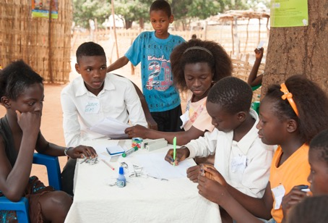
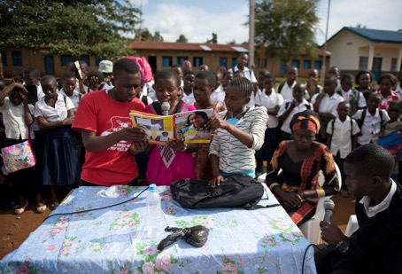
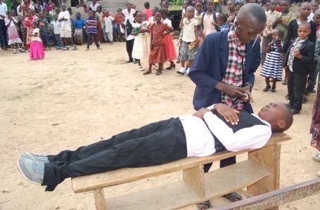
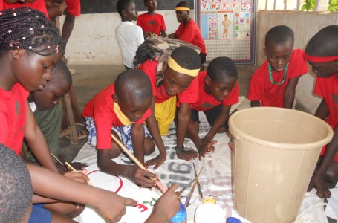
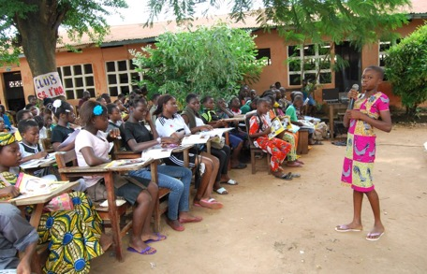
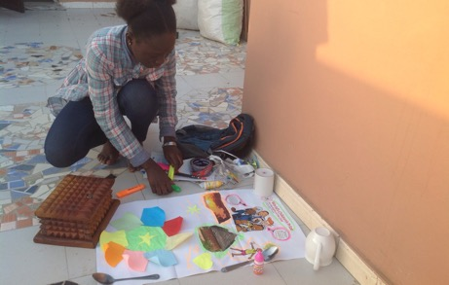
Create messages for change
Use your imagination and creativity.
Draw and paint posters.
Write and perform sketches and scenes.
Write and give speeches.
Create social media posts.
Other ideas?
Notes:
Speaking points
We will now keep working together in the same groups.
We will practice creating messages for change together.
It can be about anything related to the Rights of the Child and Girls’ Rights.
It can also be about caring for the environment.
What do you want to do? You can, for example:
Draw and paint posters and create social media posts.
Write and give speeches about issues that are important to you? Perhaps imagine that you are speaking to your head master, leaders in a local council, or even to the president!
You can also write and later perform sketches and scenes.
Do you have other ideas? Use your imagination!
To workshop leader:
The participants will reconvene in their groups.
They should have access to paint, coloured pencils/pens/crayons and paper and/or cardboard.
Make sure that everyone participates in the work and can make their voices heard.
If some participants want to work in pairs instead of groups of four, or individually, that is of course fine.

Slide 25
Present your ideas and suggestions
Notes:
Speaking points
It’s time for you to present your ideas to each other.
Who wants to start?
You may give constructive feedback to each other, but please refrain from being overly critical or negative in your remarks.
To workshop leader:
Let everyone present their ideas and suggestions in turn.
Keep an eye on the clock to make sure everyone has time to show their work, whether they put pictures up on the wall or perform a short play etc.
Allow a little time for reactions and applause after each group’s presentation. But, once again, keep an eye on the clock.
Make sure no-one responds with offensive comments or overly negative criticism. This, as well as bullying should be stopped immediately.
Document the groups’ presentations and save the materials. Of course, if children want to bring their work back home with them, they should.

