Slide 1
The World’s Children’s Prize Program
Notes:
Speaking notes
You will remember from the video with Kim and Hassan that they and their friends organized the WCP Program at their school. This included learning about their rights, teaching others, and organizing different changemaker activities. As Child Rights Ambassador you will also - assisted by your teachers - work with the Program in your schools. This will be a great help to you in your mission.
The WCP Program is the world’s largest annual education program, which empowers children to become changemakers for a better local community, country and world.
Almost 50 million children in 119 countries have participated in the annual WCP Program since the year 2000.
Soon, we will explain all the different steps in the WCP Program.

Slide 2
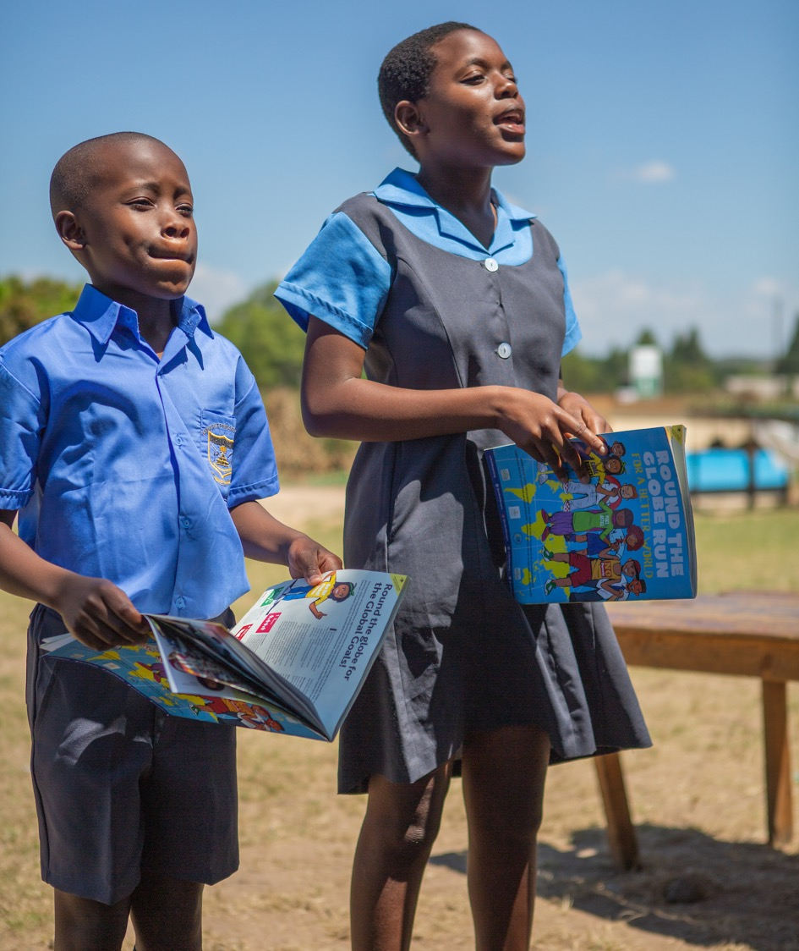
What can children do, as Child Rights Ambassadors?
Educate other children and adults too on the Rights of the Child, girls’ equal rights and the Global Goals.
Organize the WCP program and activities in schools.
Become role models, and also spokespersons when media and local leaders attend WCP activities.
Be active changemakers where you live.

Slide 3
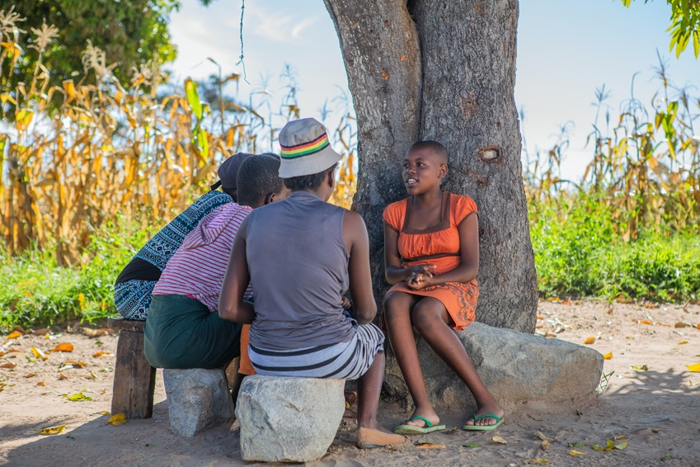
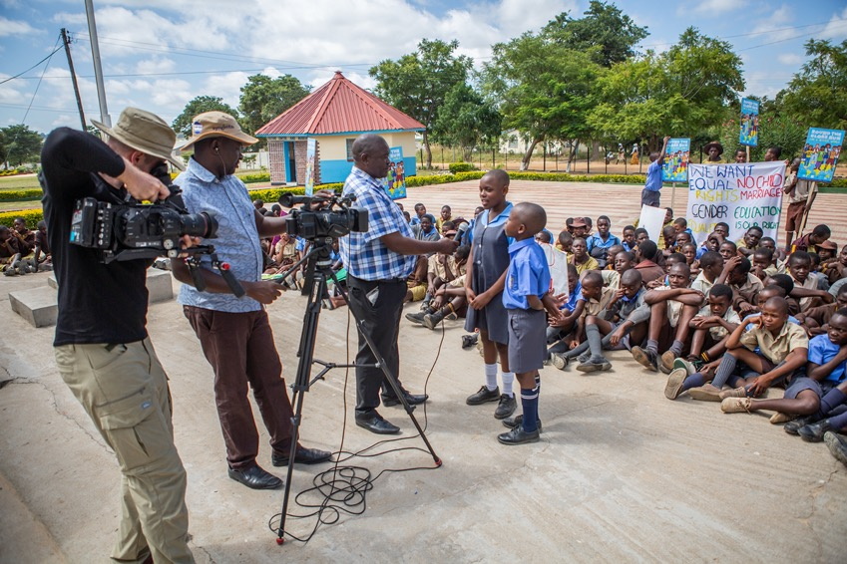
Maybe children want to:
Be a friend and confidant of vulnerable children.
Organize changemaker activities for the Rights of the Child and girls’ equal rights.
Form a Child Rights Club or any group that works together.
Share information with media, local leaders and/or local government officials.

Slide 4
Steps in the WCP Program
Notes:
Speaking points
We’re now going to go through the different steps in the WCP Program.
Each step is of course described in detail in the pedagogical guides. So once you go home, you can read up on it there and be reminded of what we talked about here.

Slide 5
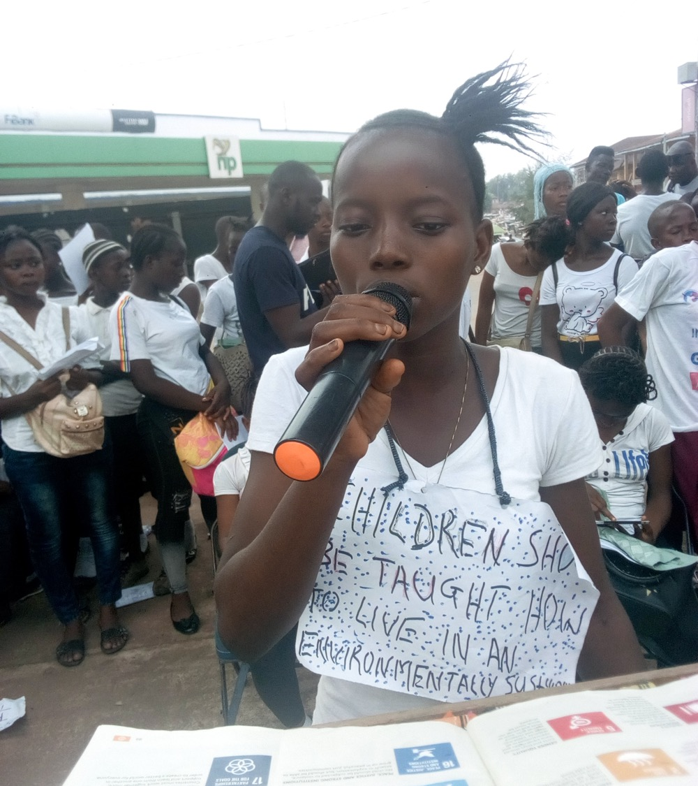
Step 1: The Rights of the Child
Learn about and discuss the Rights of the Child.
Explore what the Rights of the Child has to do with your own life, and the situation where you live and in your school.
Notes:
Speaking notes
The first step in the WCP Program is about the Rights of the Child in your own lives.
It’s important to know your own rights before starting to help others around you.
It also helps you respect the rights of others.
You and your school friends can study facts about the Rights of the Child in The Globe.
Talk to each other about whether these rights are respected where you live and in our country.
How are things at home, at school and in your leisure time?
Is there anything you’d like to change?
What obligations come with child rights?
The guides for Teachers and Child Rights Ambassadors contain tips and exercises about children’s rights in your own daily life that can be used in the classroom and in other contexts.

Slide 6
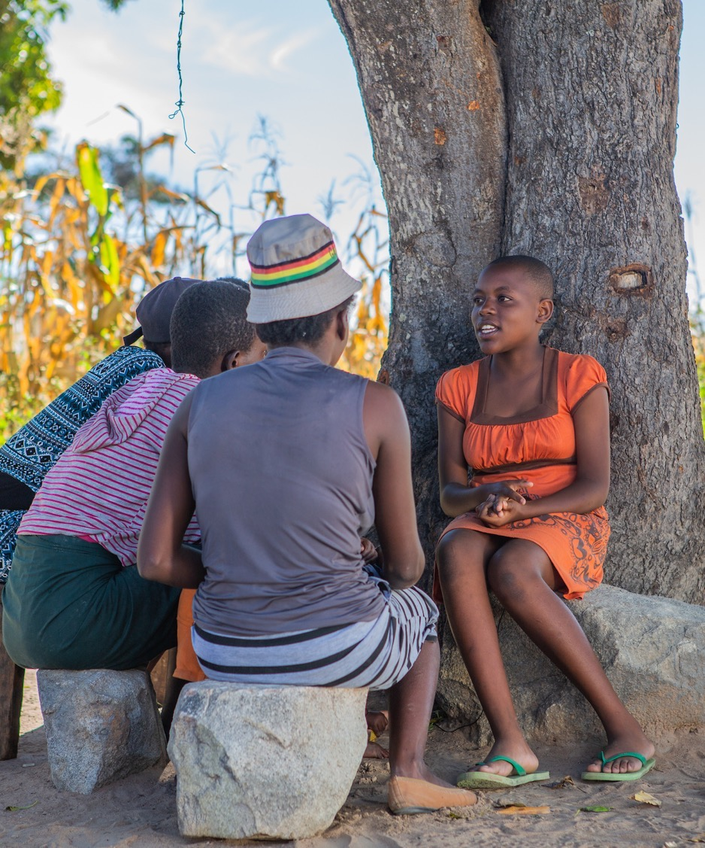
Step 2: Girls’ equal rights
Study facts about girls’ equal rights.
Talk to others about whether girls’ rights are respected where you live and in our country.
Read stories about girls in your country and other parts of the world.
Learn from stories about other Child Rights Ambassadors and how they have helped girls where they live.
Learn from stories about Child Rights Heroes who fight for girls’ equal rights.
Notes:
Speaking notes
The second step in the WCP Program is about learning about girls’ equal rights.
Girls’ rights are of course included in all other steps too. But in this step we look more closely at the situation for girls.
You can study facts about girls’ rights and read stories about girls’ lives in The Globe and online. You can also watch videos.
Draw inspiration from stories about other Child Rights Ambassadors and Child Rights Heroes.
In this photo, Child Rights Ambassador Kim discusses with vulnerable girls whether their rights are respected.
The guides for Teachers and Child Rights Ambassadors contain many tips and exercises about girls’ equal rights that you can use in the classroom and in other contexts. You can find even more information online.

Slide 7
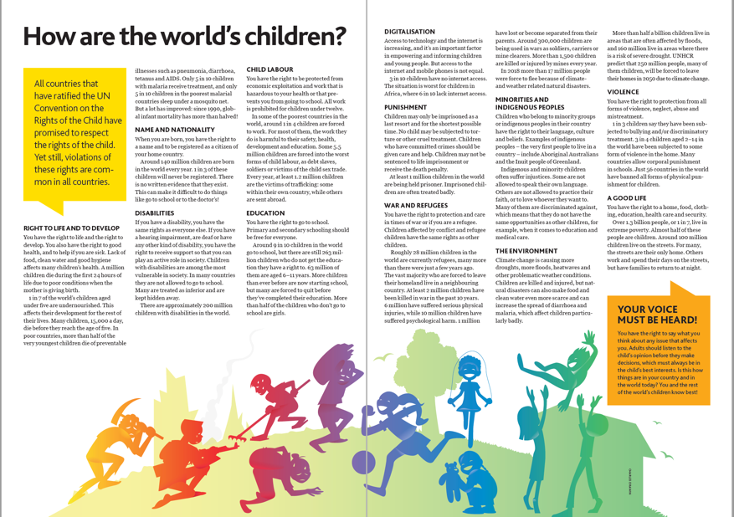
Step 3: The Rights of the Child in the world
Study facts about the world’s children.
Read stories and watch videos about children in different situations around the world.
Learn from stories about the Child Rights Heroes.
Compare facts about children’s rights around the world with how things are where you live and in our country.
Notes:
Speaking notes
Through stories and videos in The Globe and online, you and others learn about what life is like for other children around the world.
Read, for example, about the members of the WCP Child Jury and Child Rights Ambassadors who fight for children’s rights in other countries.
Compare facts and how children lives around the world. Discuss with others how things are compared to where you live and in our country.
Are there many differences?
Are there also many similarities?
What can we learn from others?
What could they learn from us?

Slide 8
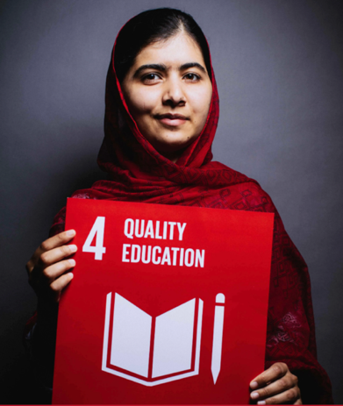
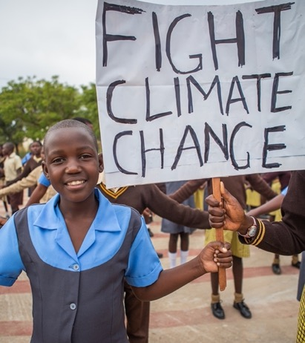
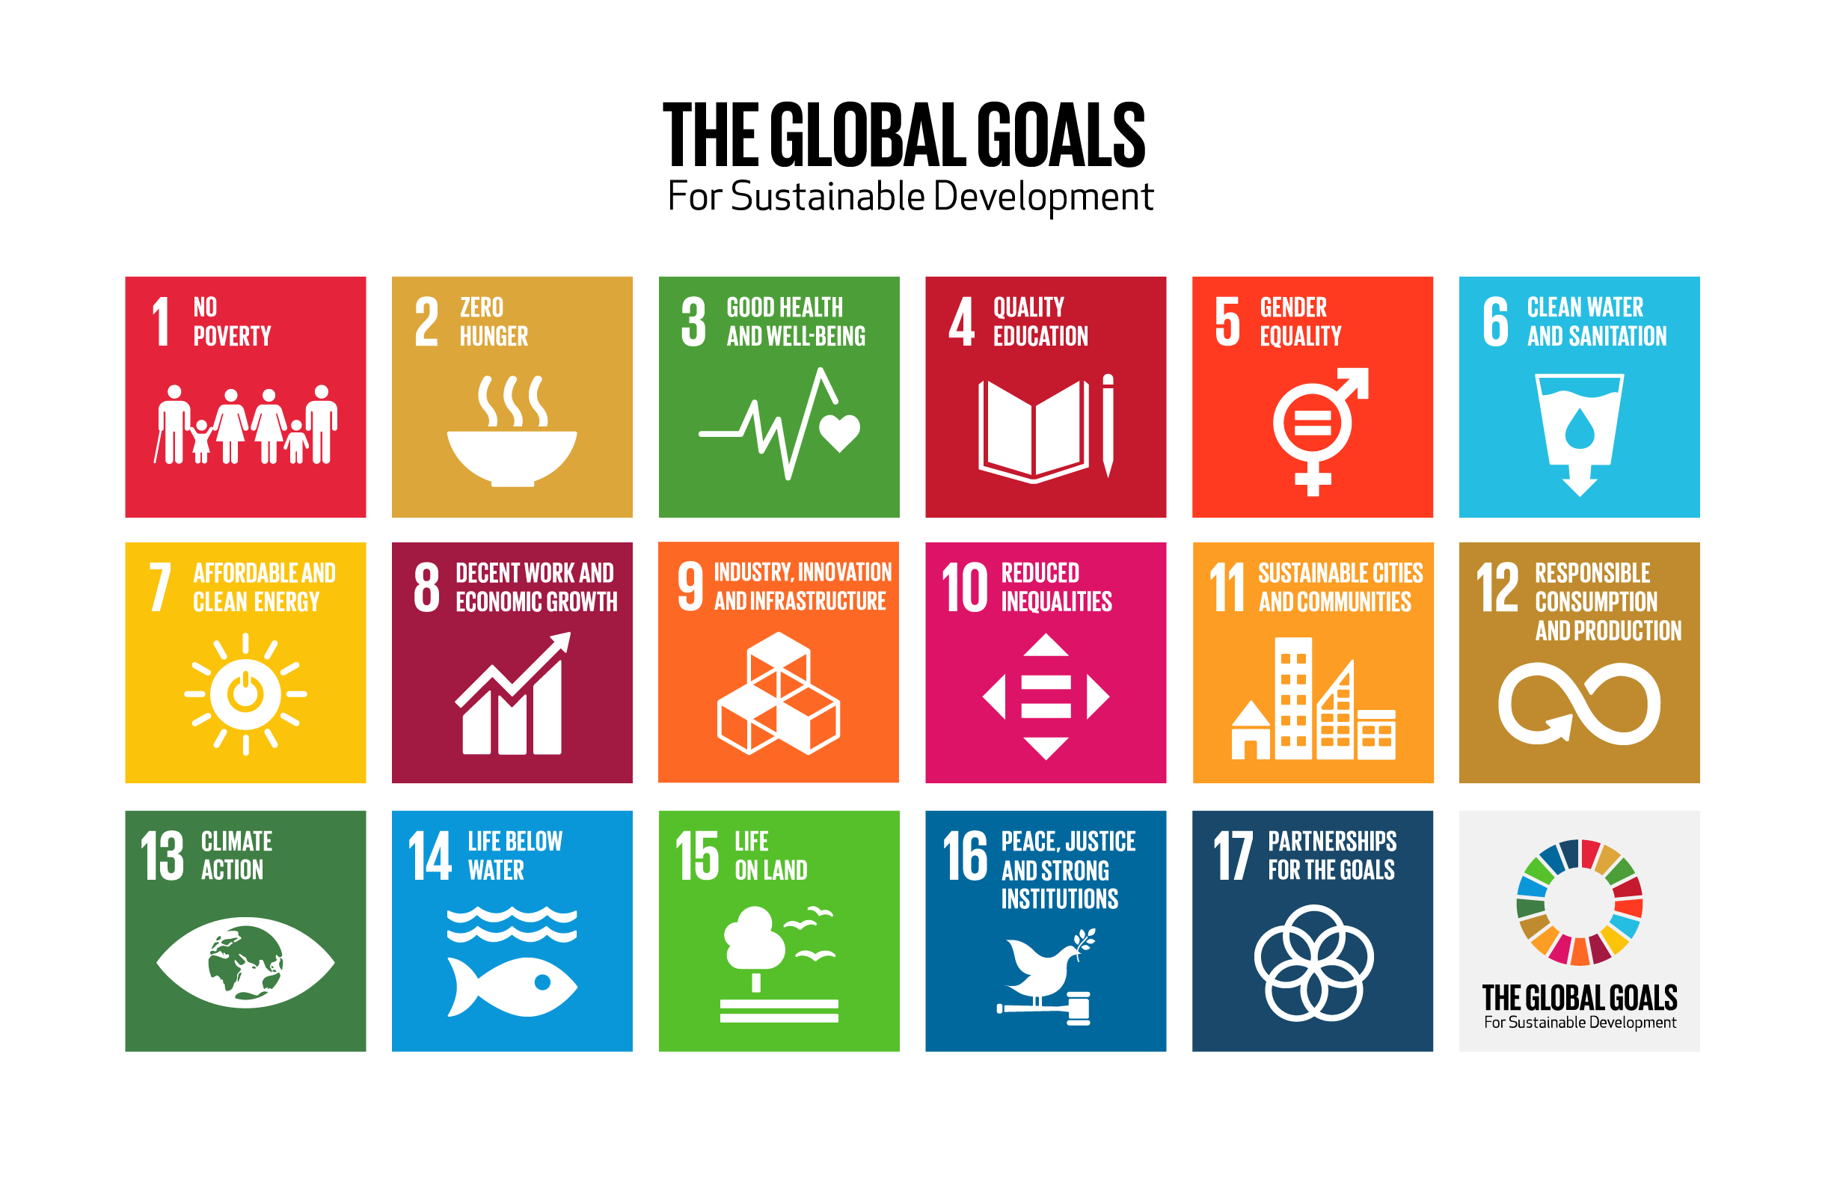
Step 4: The Global Goals
17 Global Goals for sustainable development aims to make life better for children by the year 2030 and:
End poverty.
Reduce inequalities between people and between countries.
Notes:
Speaking points:
In this step you will study the Global Goals for Sustainable Development. To “develop sustainably” means to develop, for example, new technology and build roads and factories without harming people, animals or the environment.
The Global Goals are also known as SDGs or Agenda 2030, because we need to reach them by the year 2030. If this happens, the world will be better for children and three major challenges that the world is facing will be met. We will end poverty and reduce inequalities, both between between people in countries, and between countries. Climate change will also be stopped.
It is mainly the governments of each country, including in our country, that are responsible for working to achieve the goals. It can be about making new laws and changes to the way schools and health care works. It could also be about changing laws that regulate farming practices and factory work. However, everyone can make a contribution, big or small. This goes for children too.
In the Globe and online you can find many more facts about the Global Goals and about Climate Change. The Globe also has stories about what children can do, and how the Child Rights Heroes do to contribute towards achieving the goals.

Slide 9
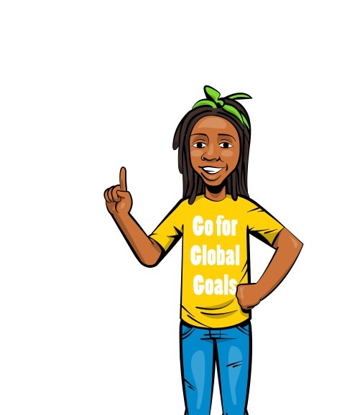
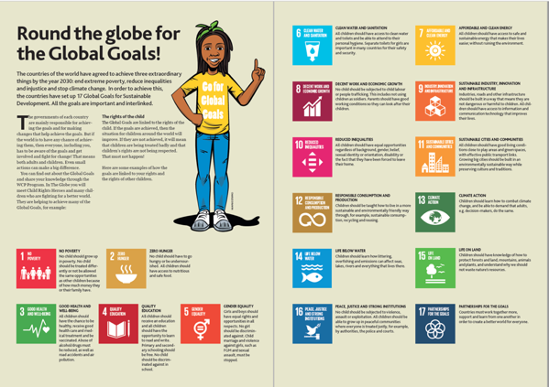
The Global Goals & Child Rights
The Global Goals are linked to the Rights of the Child.
Global Goal 5 is about reaching equality between girls and boys, women and men.
If the Goals are achieved, life will be better for children.
If the Goals are not achieved, violations of children’s and girls’ rights will continue.
Notes:
Speaking notes
The Global Goals are closely linked to the Rights of the Child.
There are goals about everything in life. Such has having a good home, the right to go to school, to have clean water, to good jobs and to a healthy environment.
If the Global Goals are achieved, then the situation for children around the world will improve.
If the Global Goals are not achieved, the situation for children will not improve and may even get worse.

Slide 10
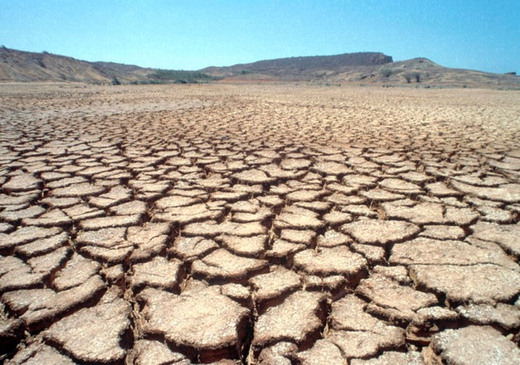
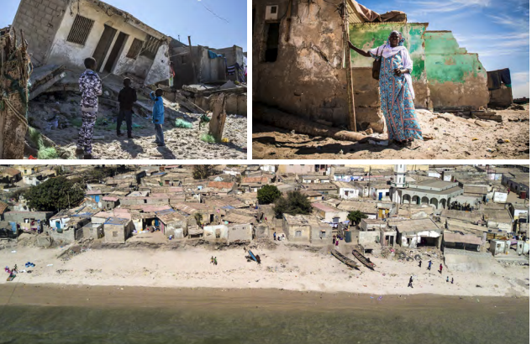
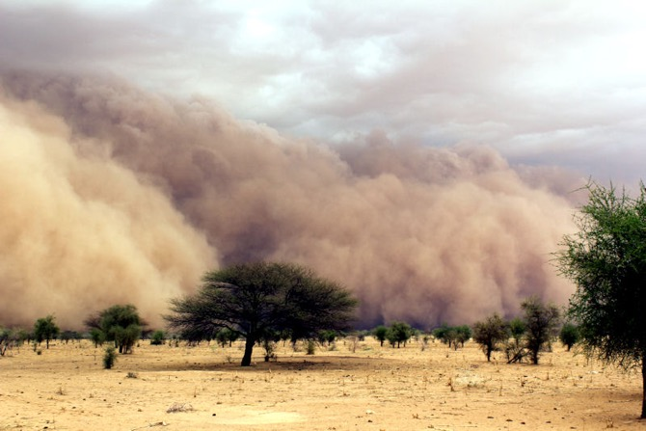
Global Goal 13:
Climate Action
Notes:
Speaking points
Global Goal 13 is about climate action
Put very simply, climate is the weather and how it changes over a long period of time.
Right now, the earth’s climate is heating up because of how governments, companies and people do things, especially in big cities and in very rich countries. So called carbon dioxide emissions from cars, coal and oil fires, factories and aircraft affect the climate badly and make the world hotter. Year by year it is getting worse.
Many people around the world have got used to wasting a lot of resources. While some people in the world hardly have or use any resources at all, other manage to use up more water, food and energy than nature can recreate.
Also, when plastic and toxic stuff such as chemicals end up in the natural environment, lakes and seas, that’s also bad for the climate.
It’s not only those who waste resources that will suffer from climate change. Everyone who lives on this planet will feel the effects.
We’re already noticing the effects in our own country and where we live.
In The Globe you can read about why climate change is happening, how it can affect children and adults, and what can be done to stop the climate crisis.
The Guide for Teachers and Child Rights Ambassadors contains more facts and exercises on climate change to use in the classroom that help you learn more and share knowledge with others.

Slide 11
How does Climate Change impact us?
This can lead to:
The Earth is heating up. Climate change can lead to:
Higher temperatures
Less rain
Extreme weather, such as storms and heavy rain
Longer, more severe droughts
Bad harvests and food shortages
Health problems
Fires and flooding
Increased poverty
Refugee crisis
Conflicts
Notes:
Speaking notes
So, right now, the Earth is heating up quickly.
This can lead to higher temperatures, and longer, more severe droughts where we live.
Changes to the climate can also mean that we get less rain and more extreme weather such as storms and heavy rain.
This can affect harvests and lead to food shortages, it can affect our health and cause fires and flooding, increased poverty, a refugee crisis and conflicts.
In some places, the dry seasons are lasting longer and rain comes less often.
In other places it might be the opposite; it may rain more often, causing flooding that destroys entire villages.
Sea levels may rise and even cover fields and homes near the coast. Then people can
be forced to leave their homes.
If the Earth heats up a lot, entire countries may become impossible to live in.
In the worst-case scenario, the changes could be so great that almost the entire planet becomes uninhabitable! Maybe not for us, but for our children or grandchildren.
No-one knows yet exactly what’s going to happen in our particular country and where we live. But we can be absolutely sure that things will happen.
To workshop leader
Adapt the above by adding local examples and facts.

Slide 12
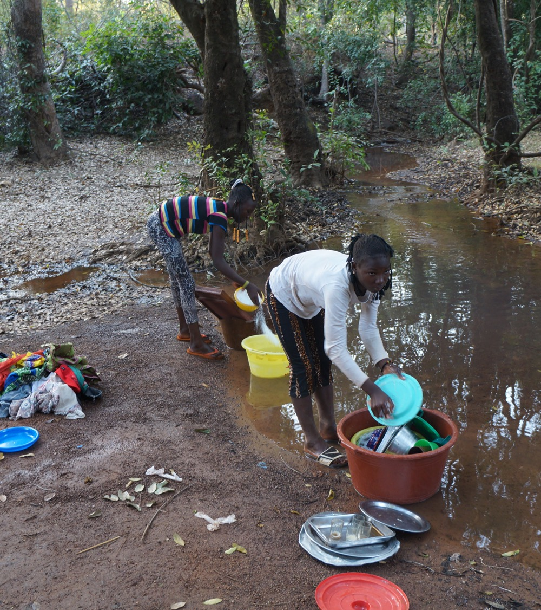
What’s it like where you live?
Think quietly for a moment: Have you or your elders noticed changes in the weather that are affecting things like:
Access to food
Access to water
Opportunities to find work and support yourself
Hotter and colder conditions
Storms and other extreme weather
Notes:
Speaking notes
Think quietly for a few minutes about whether you or your elders have already noticed changes to the weather where you live that are affecting things like access to food and water.
What happens with opportunities to find work and support yourself if the dry season is longer, or there’s more flooding?
How is the place where you live affected by hotter or colder conditions, storms and other extreme weather?
Talk about this with your parents and grandparents when you get home.
To workshop leader:
Adapt to local conditions as needed.

Slide 13
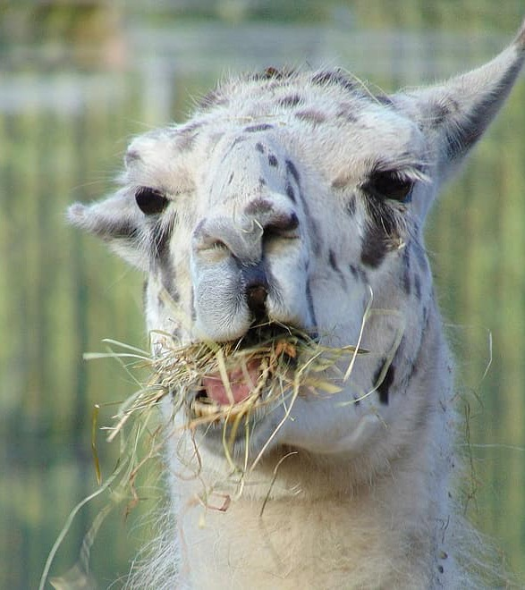
Meal break
© Inter IKEA Systems B.V. 2020

Slide 14
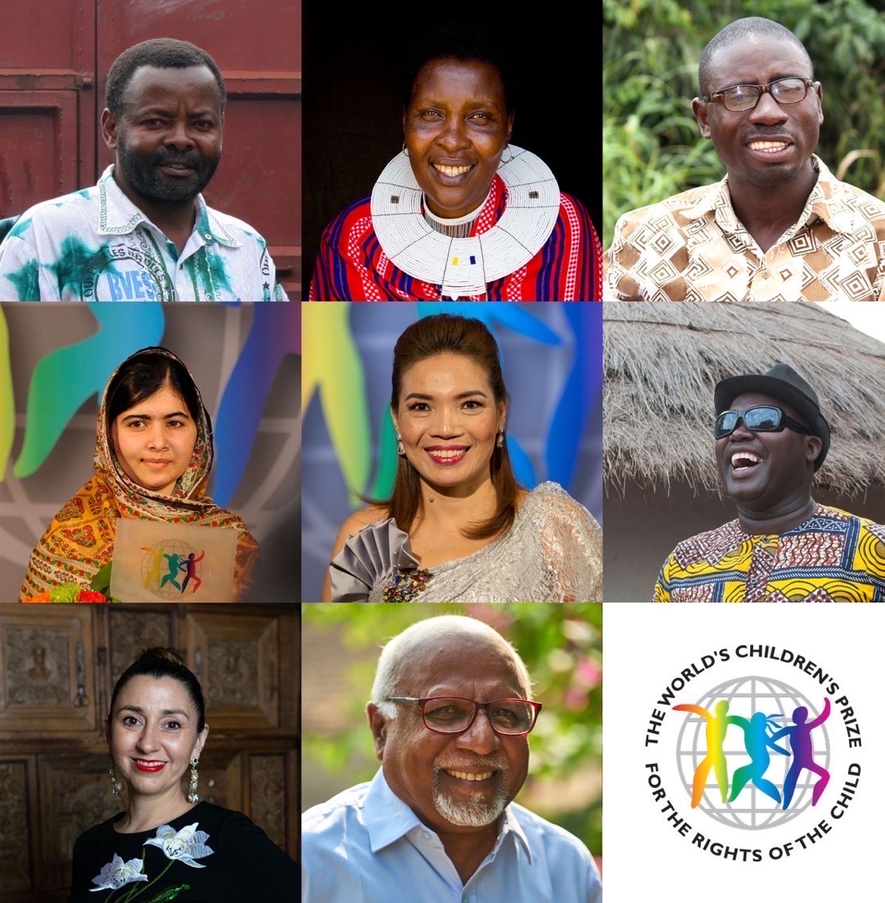
Step 5: The Child Rights Heroes
Every year, three Child Rights Heroes are nominated for the World’s Children’s Prize.
Millions of children take part in a Global Vote and, after learning about the Heroes, vote for their favourite.
This year is a little different. Now, eight Heroes are nominated.
They have all previously been awarded the World’s Children’s Prize and are now nominated to become the Decade Child Rights Hero.
Notes:
Speaking notes
Part of the WCP Program is about learning about Child Rights Heroes and their organizations for change.
Every year, Child Rights Heroes are nominated for the World’s Children’s Prize.
Millions of children learn about the Child Rights Heroes in the Globe and online.
Then each child vote for their favourite in a Global Vote.
The candidate who receives the most votes is awarded the World’s Children’s Prize and named Child Rights Hero of the Year.
However, this year is a little different.
Normally three candidates are nominated. Now, eight Heroes are nominated.
They have all previously been awarded the World’s Children’s Prize.
They all have the chance to be voted WCP Decade Child Rights Hero by children in our country and across the globe.
The last time the children of the world chose a Decade Child Rights Hero was ten years ago. Back then a total of 7.1 million children voted for Nelson Mandela, freedom fighter and former president of South Africa, and Graça Machel, a Child Rights Advocate from Mozambique.
We will shortly tell your more about the Global Vote.

Slide 15
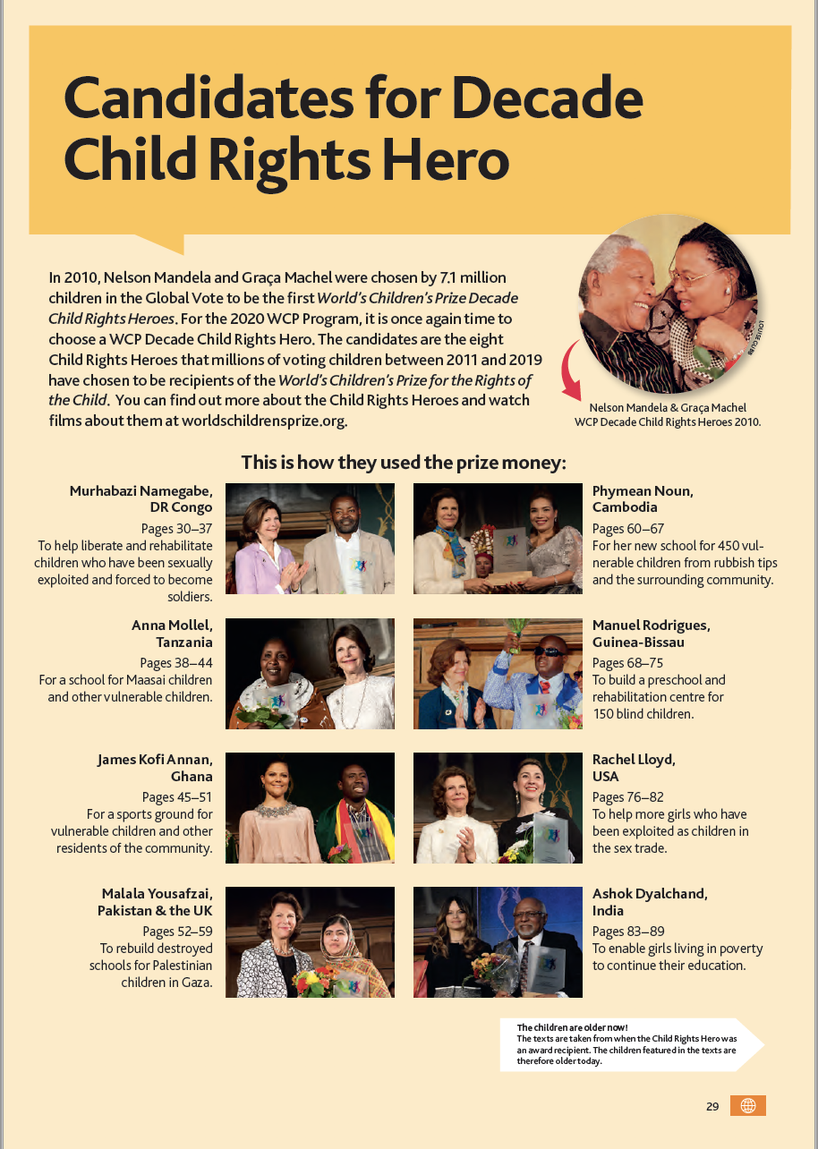

Child Rights Heroes
Inspirational role models.
Have fought prejudice and injustice.
Fight for boys and girls who have their rights violated
Defend the equal rights of girls.
Many have had their own rights violated as children.
Notes:
Speaking notes
The nominated Child Rights Heroes fight for all children to be treated fairly and to have a decent life. They are role models that can inspire us.
While most Child Rights Heroes fight for a better life for both boys and girls, some of them work in particular to defend the equal rights of girls. Their work can also give us ideas about what we all can do to bring about change where we live and in our country.
Many of the Child Rights Heroes are women. Some have fought prejudice and for girls’ rights since they were young girls’ themselves. The male Child Rights Heroes also fight for equal rights for girls, and encourage boys to respect and defend girls’ rights.

Slide 16
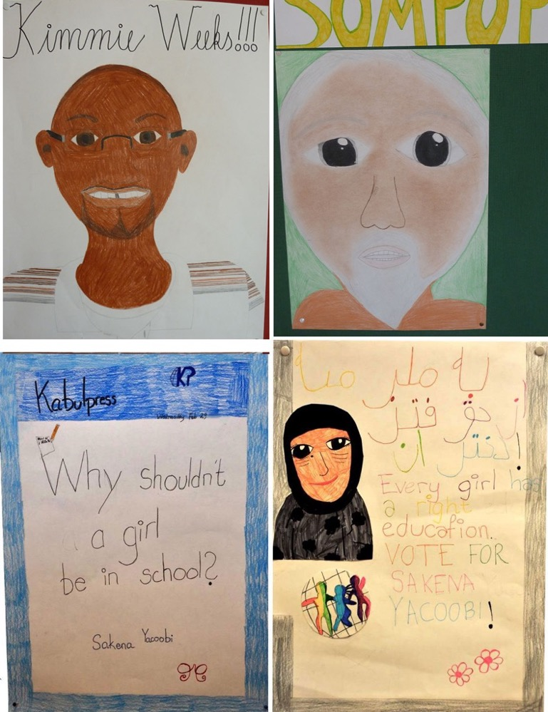
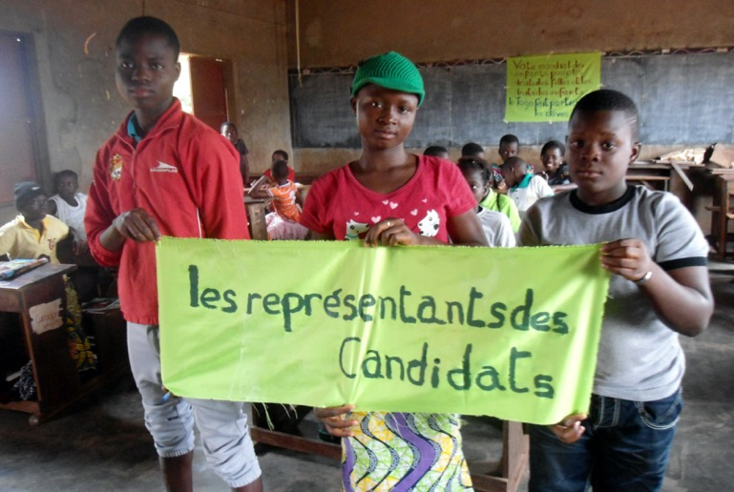
Creative activities: Draw and paint. Act out scenes from the Child Rights Heroes’ lives and the children’s lives
Notes:
Speaking notes
There are plenty of great and fun ways to learn more and raise awareness of the Child Rights Heroes and the children they fight for. The guide for Teachers and Child Rights
Ambassadors contains suggestions and tips.
You can draw and paint pictures or act out short scenes from their lives. Or write and give speeches, playing the role of the Child Rights Heroes. Then use your short plays and drawings when you share information about the heroes with others.
The Guide for Teachers and Child Rights Ambassadors contains facts about the Heroes, give tips on activities and lesson plans, and explain how the Child Rights Heroes contribute towards achieving the Global Goals.

Slide 17
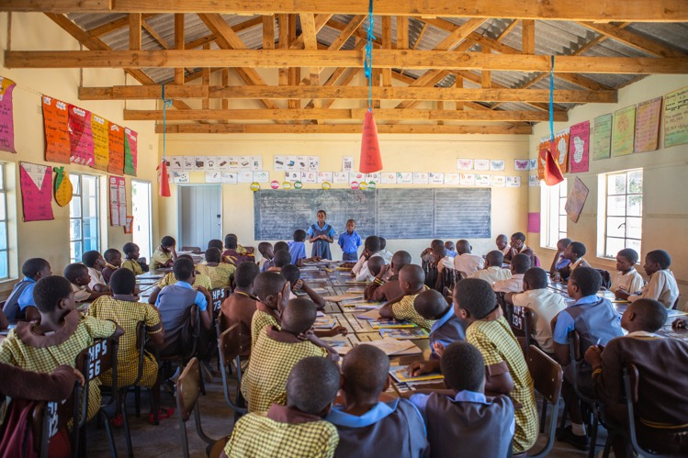
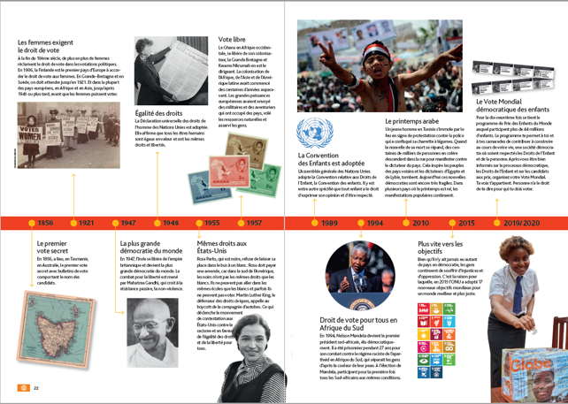
Step 6: Democracy and election campaigns
Study the basic principles and history of democracy in The Globe.
Compare what you’ve learned with democratic developments and the situation where you live and in your country.
Discuss how democracy works where you live, and throughout the country. What is good, and what is not so good?
Notes:
Speaking notes
This stage is about understanding how democracy and election campaigns work in practice.
Who makes the decisions in your country, where you live and at home, at school and in your leisure time?
Read about the basic principles of democracy in The Globe, and about how democracy has developed around the world.
Compare this with how democracy functions and has developed where you live and in our country. Discuss what works well at the moment, and what could be improved.
The Guide for Teachers and Child Rights Ambassadors contains facts about democracy, and threats to democracy such as corruption and cheating.

Slide 18
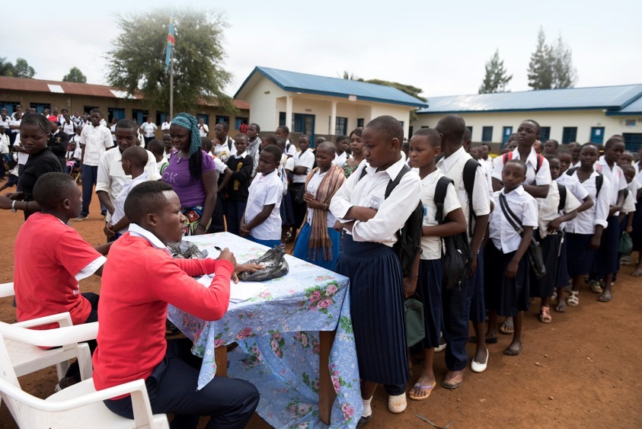
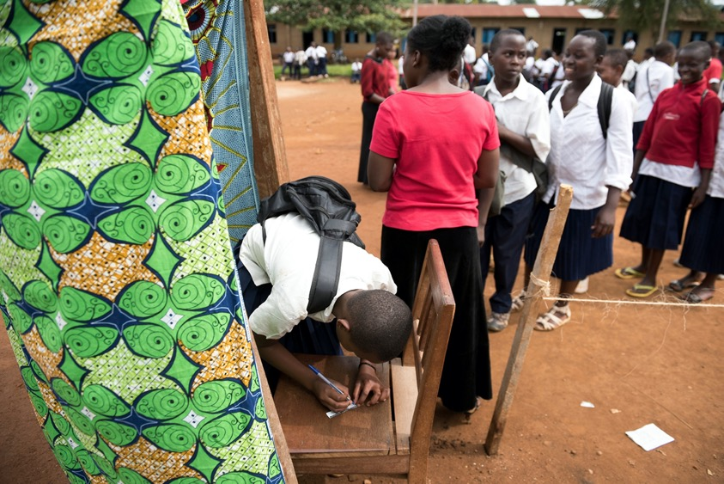
The Global Vote
Takes place when all children have enough knowledge about all the candidates.
Is organized on a Changemaker Day.
Child Rights Ambassadors organize the Global Vote with support from other students, teachers and school leaders.
Only children up to 18 are allowed to vote.
Organise an opening ceremony
Notes:
To workshop leader:
Ask the participants to turn to the page about stage 7 in the Guide for Teachers and Child Rights Ambassadors, and to look at it while you speak.
Speaking notes
This stage involves organizing your own election at your school, with the support of teachers and school leaders, on Changemaker Day. The vote is held once all the students have enough knowledge of all the candidates and their work.
Appoint election officiators, vote counters and other election workers from among the Child Rights Ambassador and students.
You need an election register, which is a list of all students who have the right to vote.
You also need ballot papers, voting booths and ballot boxes.
If you want, you can have a vote day ceremony and invite family and local leaders.
Children and young people have the right to vote up until the year they turn 18.
Adults are not allowed to vote. However, they can support you in organizing your election day.
Make sure you carry out your vote correctly without any risk of cheating.
The guides for Teachers and Child Rights Ambassadors contain a clear, step-by-step description of how to organize your vote day, including tips on everything from making campaign materials, to how to carry out the actual vote.

Slide 19
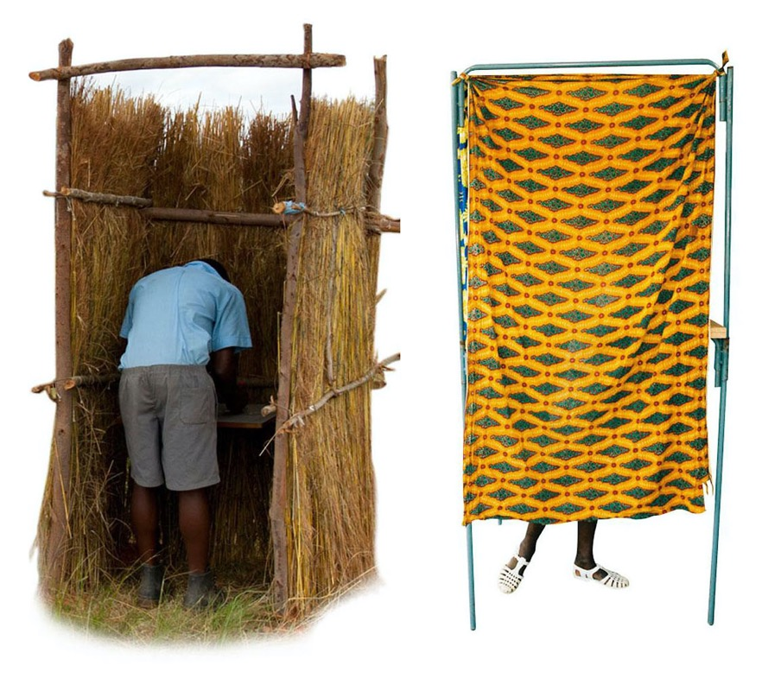
Voting booth for secrecy
A voting booth is necessary to make sure voting is secret.
Use your own creativity and local materials to build a booth!
No-one has the right to influence your choice!
Go into the voting booth and cross over or circle the name of the candidate you prefer. Fold the ballot.
Finally, put your ballot in the ballot box.
Notes:
Speaking notes
No-one else should be able to influence your vote, whether they are a friend or anyone else. And no-one has the right to demand that you tell them who you voted for – it’s up to you if you want to tell.
These voting booths come from schools in Zimbabwe and Ghana.
To maintain the secrecy of the ballot, you need a voting booth so no-one can see who the children are voting for.
Use your imagination when making your voting booths!
Some schools contact the local election authority and are allowed to borrow their official voting booths, but it’s often more fun and nicer to make your own.
Remember that everyone should have sufficient knowledge of all candidates before they cast their vote.
When it’s time to vote, you enter the voting booth and mark a cross next to your favourite, then fold your ballot paper.
Finally you put your vote into the ballot box.

Slide 20
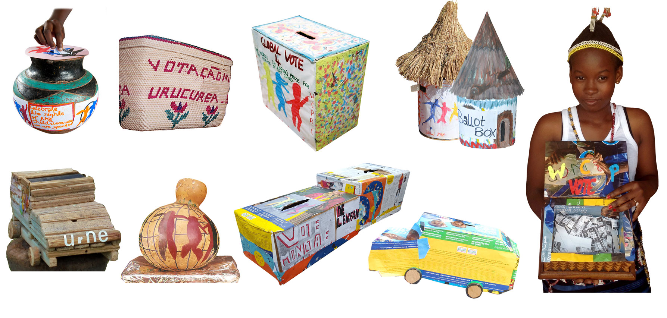
Create ballot boxes
Notes:
Speaking notes
You will make your own ballot boxes.
They can be made from cardboard or old jars, pots or plaited palm leaves.
These ballot boxes come from different countries in the world. Do you have any design ideas for a ballot box?
Be imaginative and be inspired by other children’s ballot boxes in The Globe.
Every year, children send pictures of their ballot boxes to the WCP.
Some of the best, prettiest and most fun end up being featured in the next issue of The Globe.

Slide 21
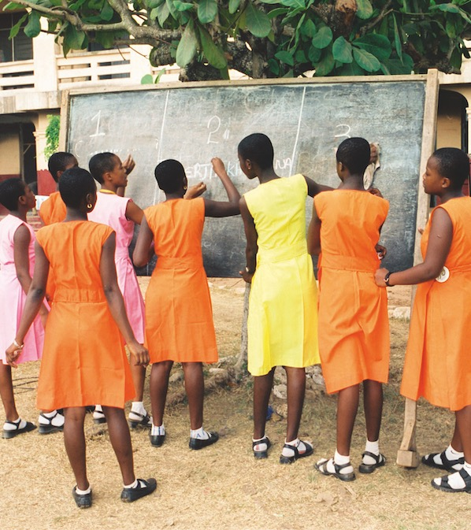
Count the votes!
Once everyone has voted, the vote counters begin their work. Finally, the result of your Global Vote can be announced.
The results for each of the candidates are reported to the WCP focal point in your country
Notes:
Speaking notes
Once all children have voted, it’s time to count the votes.
Finally, your school’s results can be revealed.
Afterwards, the result for each candidate is reported to the focal point in your country. It’s usually a teacher or head teacher who is responsible for reporting to the focal point.
The WCP adds up all votes from across the whole world, so it’s not just about who got the most votes at your school. Then, finally, the total result is revealed.
The Global Vote is not a competition. Therefore the World’s Children’s Prize never use the word Winner. It’s about honouring three magnificent champions for the rights of the child. The Global Vote divides the awards between them.

Slide 22
Practice vote: Corporal punishment should be banned in schools. YES or NO?
Now let’s vote!
We’ll need some election workers.
Get into a queue. Keep your distance.
Everyone will be ticked off on the election register, one at a time, and will be given a slip of paper.
Go into the voting booth and write YES or NO on your slip, fold it and then leave.
Put your vote in the ballot box
The election worker marks you with ink or a stamp so you cannot vote twice.
Notes:
Speaking notes
You’re now going to vote on whether you think corporal punishment, that is hitting students, should be banned in school. You can vote YES or NO.
This is how it works:
• Get into a queue. Keep your distance!
• Everyone will be ticked off on the election register, and will be given a slip of paper. Go into the voting booth, one at a time.
• Write YES or NO on your slip, fold it and then leave. Put your vote in the ballot box!
• The election worker marks you with ink or a stamp, so you cannot vote twice.
To workshop leader:
The idea of this brief, fun exercise is to give a quick, practical experience of how voting works, so Child Rights Ambassadors and teachers are better prepared when they run their own votes. During the break, the speaker and voluntary election workers (3–4 people) all help to quickly set up the ballot boxes and voting booths.
Prepare the following BEFORE you start the training session.
• Make a simple ballot box or prepare a fantastic box well ahead of time.
• Make sure you have an inkpad or colour pen/stamp, that all participants can be ‘marked’ with after they have put their vote in the ballot box.
• Bring an extra copy of the list of participants to function as an election register, which can be used to tick off everyone voting during the exercise.
• Bring materials to use for the voting booth. It doesn’t need to be complicated. For example, use a large piece of fabric to hang up in a corner, or use something else to screen off a corner or part of a room so everyone can vote in private.

Slide 23
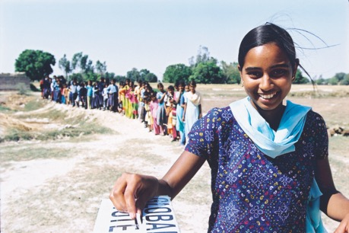
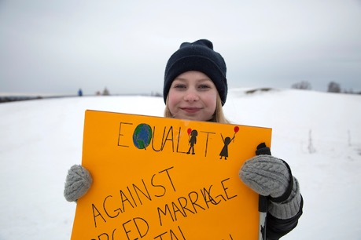
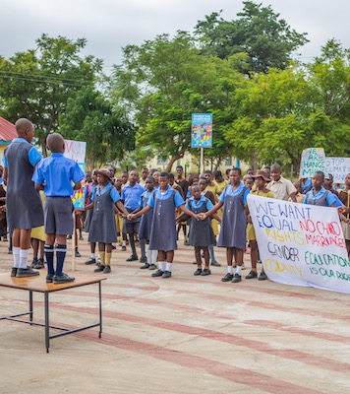
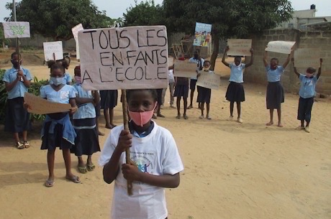
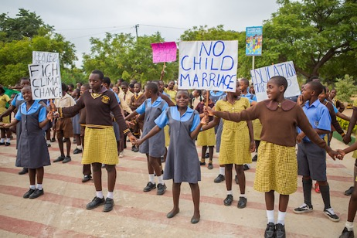
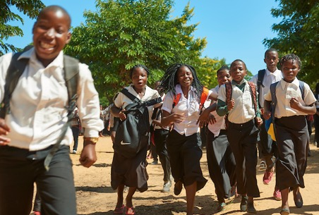
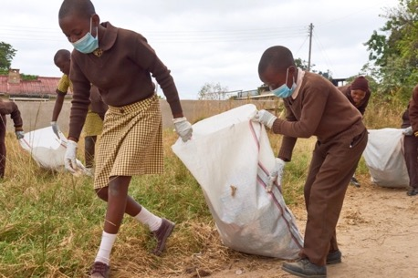
Changemaker Day
Notes:
Changemaker Day
The Global Vote
The Children’s Manifestation for Change
The Round the Globe Run
Speaking notes
As we said before, at the end of the annual WCP Program, you, as Child Rights Ambassadors, with the help of your teachers, will organize a Changemaker Day at your schools.
Most schools have their Global Vote, Children’s Manifestation for Change and Round the Globe Run or Walk on the same Changemaker Day.
You can also have two different Changemaker Days, one for the Global Vote and one for the Round the Globe Run or Walk. However, you will then have a Children’s Manifestation for Change on both occasions.
On a Changemaker Day you as Child Rights Ambassadors lead fun and impactful changemaker activities, involving and engaging all students in your schools. Of course, teachers and school leaders support you so that everything runs smoothly.
You can invite your families as well as the media, local leaders and local government officials to come to your Changemaker Day.
They will then experience activities like the following (change slide)

Slide 24
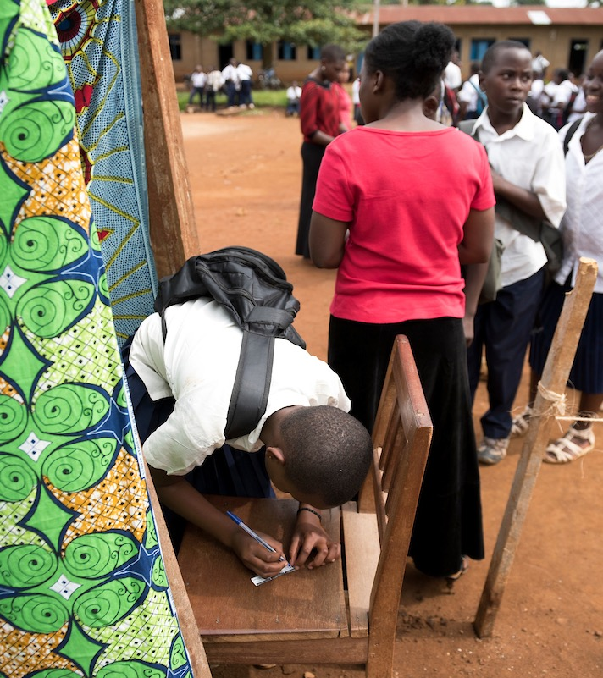
The Global Vote
Start your Changemaker Day with the Global Vote for the Rights of the Child.
Notes:
Speaking notes
Because Changemaker Day is held at the end of the WCP Program, all the students have learnt about their rights and have enough knowledge of all the candidates and their work. That is when it is time to vote!

Slide 25
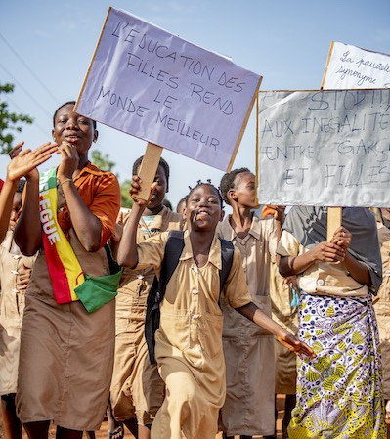
The Children’s Manifestation for Change
Make placards, banners and speeches with your demands for change,
Walk to the centre of your village or town.
Share your messages and raise your voices
Speak to the media
Notes:
Speaking notes
The Children’s Manifestation for Change is your manifestation for children’s rights, girls’ equal rights, the environment and the climate. You can make your voices heard about issues that are important to you and your friend, including stopping violence and other violations of children’s rights. Make posters, placards, and banners and write speeches about you the issues and your demands for change.
All children at your school and/or in your community can join in the manifestation. Walk together to the center of your village or town, while showing your messages with the whole community. Give speeches and, if you like, sing, dance and include other performances in your manifestation
You can invite local media as well as local leaders, organizations, authorities and families to your manifestation. Do it in good time, and repeat your invitation the day before your Changemaker Day.

Slide 26
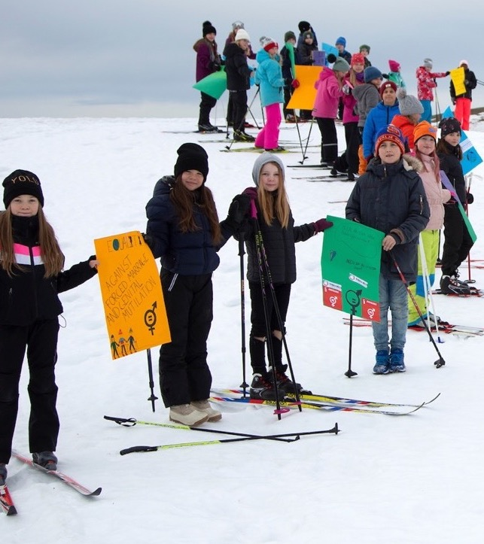
Round the Globe Run
Run, walk, dance or whatever you like for 3 kilometres
Bring your placards and banners
Notes:
Speaking notes
Now, you continue the Children’s Manifestation for Change with the Round the Globe Run. Through running or walking, or maybe dancing or skiing, you highlight the changes you want to see for a better village or town, country and world.
Children in many countries around the world do the same. Together you bring your messages millions of kilometres and up to a hundred laps around the globe! A teacher will later report to the local WCP Focal point how many children participated in the manifestation, and took part in the three km-run, or walk .
Think about that while we watch this short video about children in Sweden who used skis in the snow on their Changemaker Day!
To workshop leader:
Find the link here:
https://youtu.be/4gIAhGi79Fk
To workshop leader: After you have seen the video, let participants raise their hands and give suggestions if they want for how they want to do the “run” part.

Slide 27
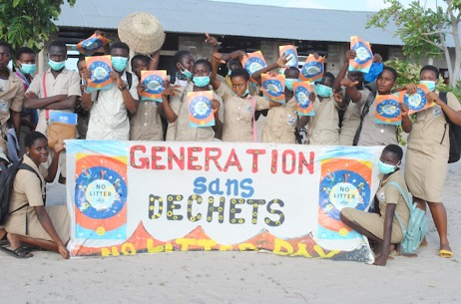
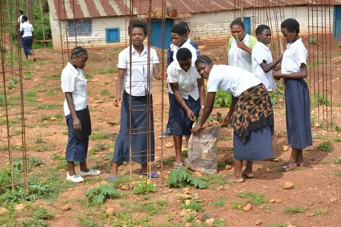
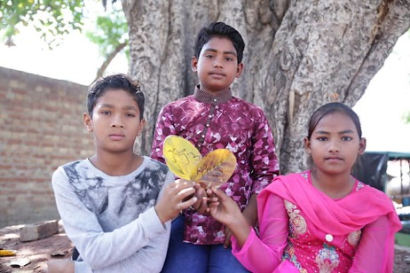
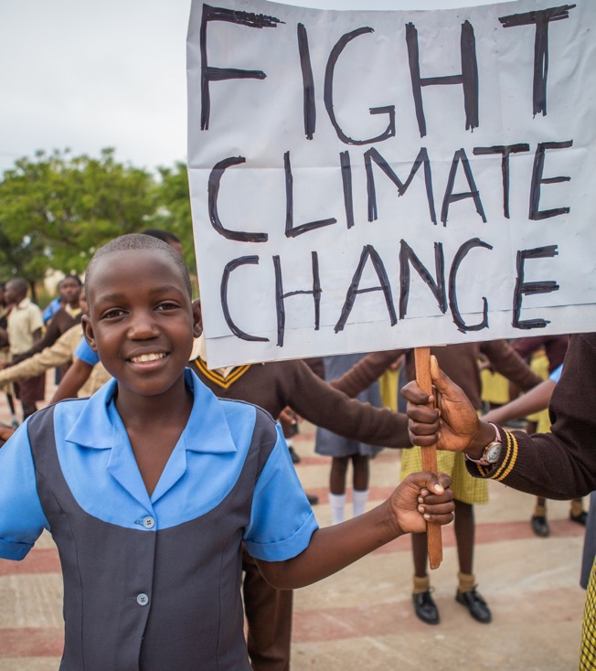
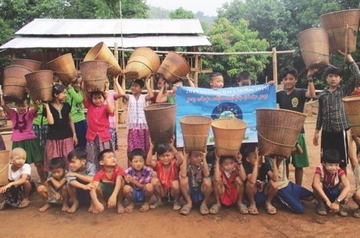
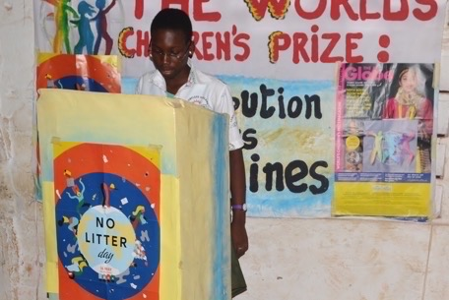
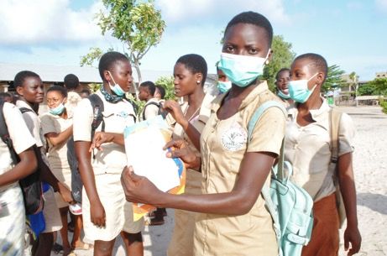
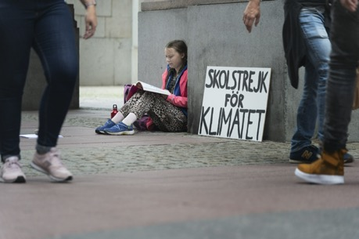
Climate action with litter picking
Notes:
Speaking notes
Another activity that you also can include on Changemaker Day is a litter-picking activity in school grounds and/or surrounding areas. Buy picking litter you are showing your community the importance of caring for the environment and setting a good example. Of course adults can help too.
You can also share information with people that you meet about climate change and the need for climate action, including combatting littering.
Many WCP schools have established an annual No Litter Day in their schools. Does your school have one?

Slide 28
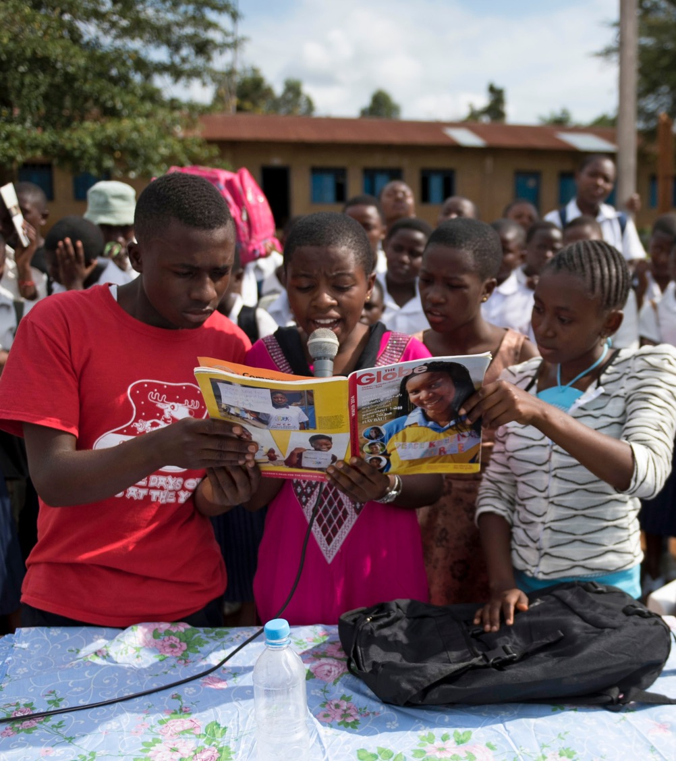
Your day – your decision!
Adapt your Changemaker Day and activities to your local situation.
You can do all events in one day, or have two Changemaker Days.
Notes:
Speaking notes
Remember: It’s your day and your decision!
We have shown you all the exciting events and fun activities that can be part of your Changemaker Day.
Once it comes time for you to plan your own Changemaker Day, you will have to decide together if you will include all events in one day, or on different days. It can be during the same week or over a longer period of time. You should adapt your Changemaker Day and activities to your local situation.
Ask your teachers and school leaders for support in the planning process and preparation.

Slide 29
Result of the vote!
?
Notes:
Speaking points
Present the results of your vote.

Slide 30




Follow and Connect
worldschildrensprize.org
YouTube.com/worldschildrensprize
#childrightsambassador
#changemaker
#worldschildrensprize
#globalvote
instagram.com/worldschildrensprize
facebook.com/worldschildrensprize
twitter.com/wcpfoundation
Notes:
Speaking points
If and when you have internet access, you can follow us on social media.
Please share your own thoughts and photos there too, and tag it with #wcpprogram and #childrightsambassador
On the WCP website, you find stories, videos and much more.

